Slide 1
Eyes on God
Ephesians 1:3
We have something to boast about
UPWARD

Slide 2
God-centered and Christ-focused
Who we are & how we are to live
Saints & faithful
In grace & peace.

Slide 3
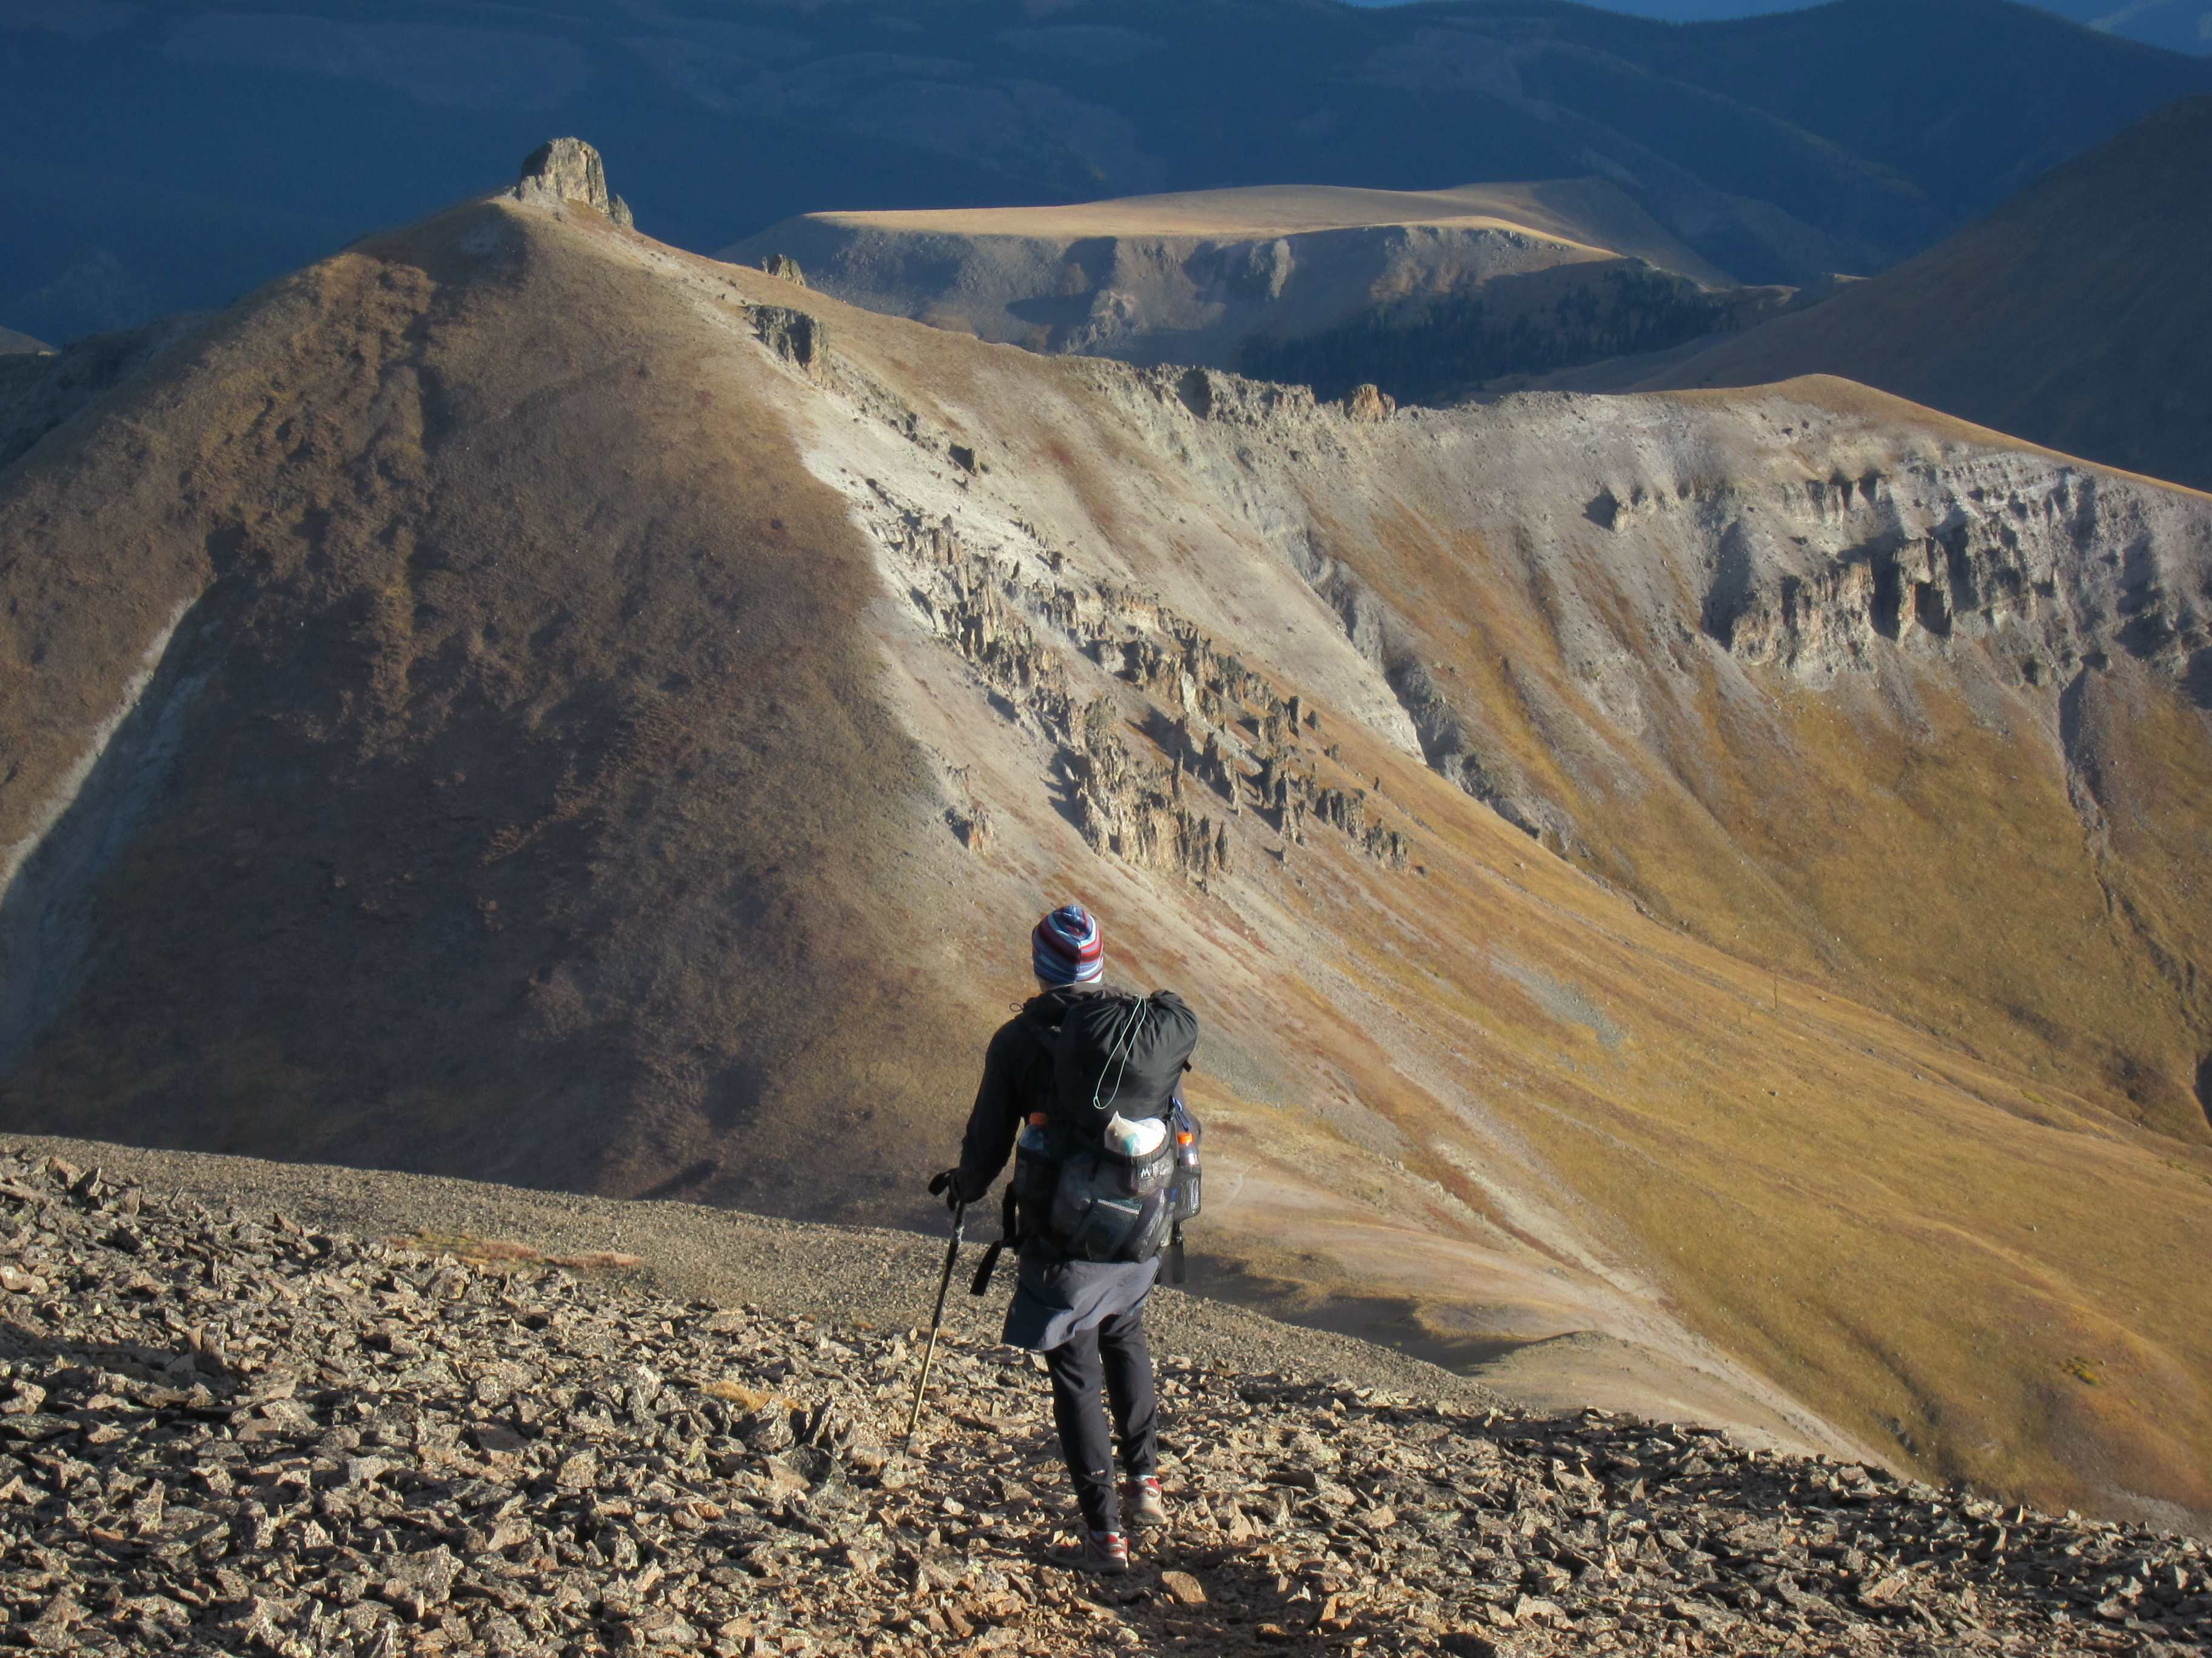
God’s Great Plan
1:3-14 panoramic view of God at work
Praise! (1:3)
Greek:
ευλογητος
“speak well of”
You can only brag about what you know.
Kneel before God and boast of who he is!
We can’t praise God if
we don’t know him.

Slide 4
Blessed Us (1:3)
Bless be God, who has blessed us with blessings
What happens when God blesses us?
There is a change in relationship:
He is “Father”
The beginning point is from whom
the blessing comes – not so much what
the blessing is.

Slide 5
All Spiritual Blessings
Nothing lacking
God is not stingy
We have every single one.
Spiritual
The intangibles that give life meaning.

Slide 6
In the Heavenly Realms
It is the unseen real world
that truly matters now and forever
This “heavenly realm” is our present real, reality that when we ‘see’ it we will live different lives.
We live in heavenly realms, with a heavenly citizenship enjoying the spiritual blessing while using them
in a physical world
“I live! Yet not I! Christ living in me!

Slide 7
In one continuous sentence Paul pours forth his praise of
what God has done for us.
When we truly see God there will
well up in us gratitude that will overflow into our daily lives.

