Slide 1
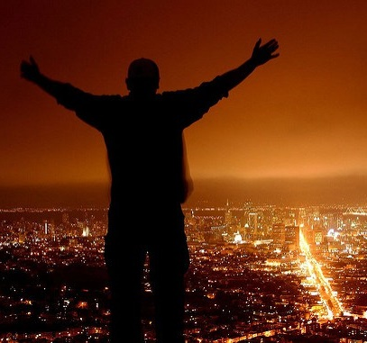
Tell Aaron and his sons, ‘This is how you are to bless the Israelites,
Say to them:
‘The LORD bless you and keep you; the LORD make his face to shine upon you and be gracious to you; the LORD turn his face toward you and give you peace.’
So they will put my name on the Israelites, and I will bless them.
Numbers 6::23-27

Slide 2
The Lord Bless You and Keep You
C / G
Words and Music by: Peter C. Lutkin
© 2001 The Paperless Hymnal™
2 / 4
Notes:
C/G
Assurance, Benediction, Blessing, Peace

Slide 3
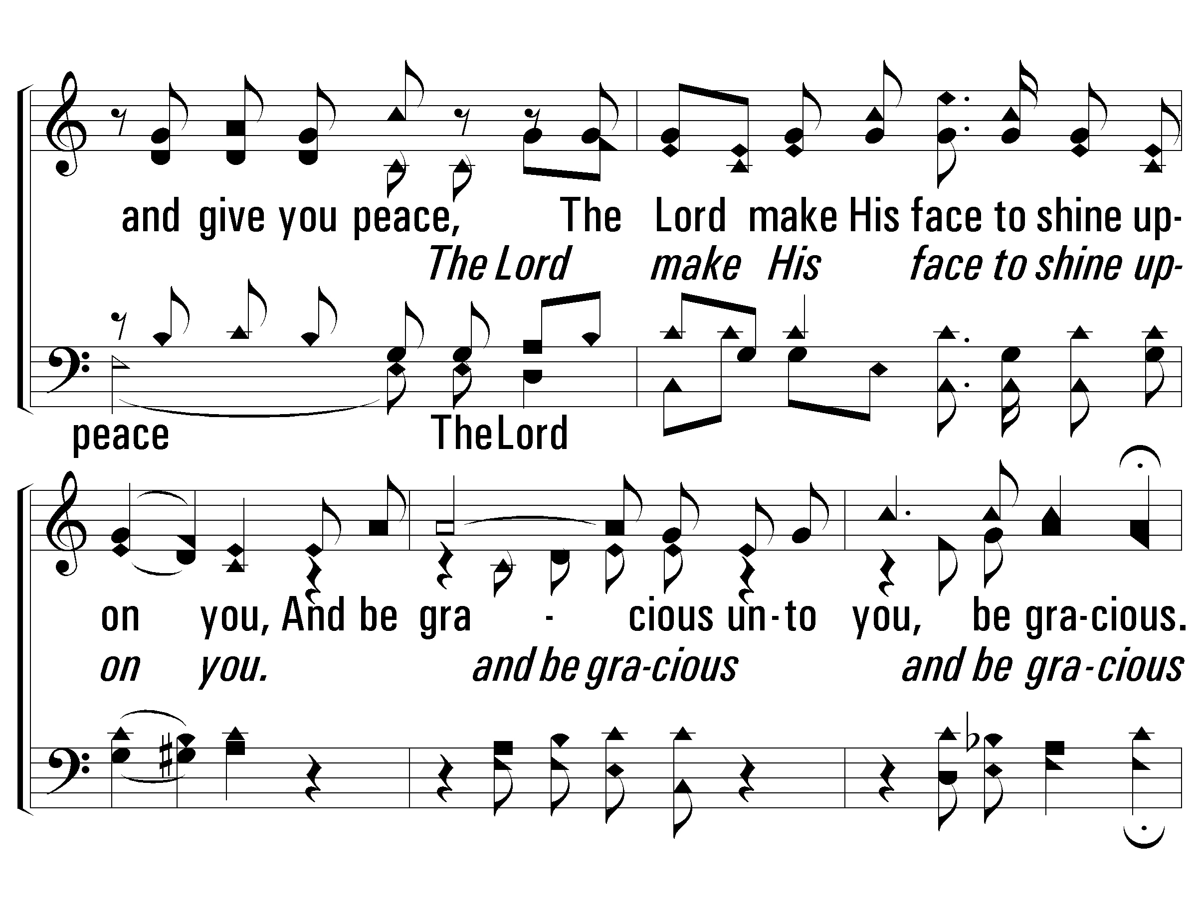
The Lord Bless You and Keep You
3 / 4

Slide 4
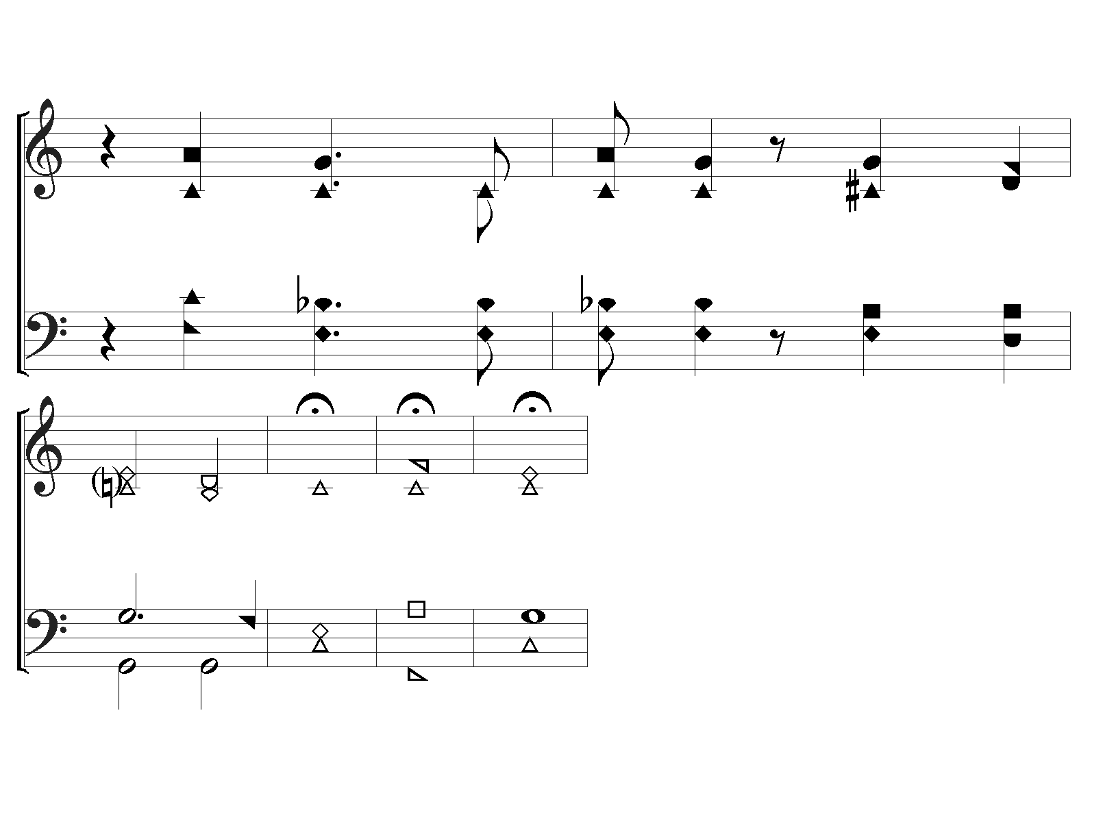
The Lord Bless You and Keep You
END
The Lord be gra - cious, gra - cious
un - to, you. A - men
4 / 4

Slide 5
Everything must be fulfilled that is written about me in the Law of Moses, the Prophets and the Psalms
Luke 24:44
“Lord” ~ “Yaweh” ~ יְהוָ֖ה
God-centered instead of blessing-centered.

Slide 6
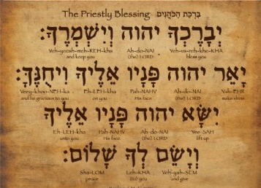
12 words in the Hebrew
“3 in 1” blessing
bless and keep;
make his face shine upon you/be gracious;
turn his face toward you/give you peace.

Slide 7
Lift his face and Peace
(Relationship/Wholeness)
Face Shine and Gracious
(Smile/Beautiful to behold)
Bless and keep
(Serve/Protect)

Slide 8
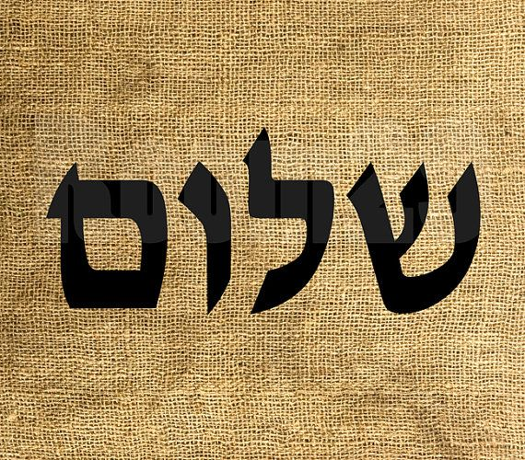
Shalom
Peace
Absence of war or conflict. Wholeness,
completeness, well-being
“the way life should be”
And Give you Peace

Slide 9
Root word ‘Salem’ ~ “repay”
Ex 21:34 – when a person damages someone else’s property he must “pay back” – restitution
Salem - brought back to its original state:
When Salem takes place the result is Shalom
People can only do this partially and incompletely

Slide 10
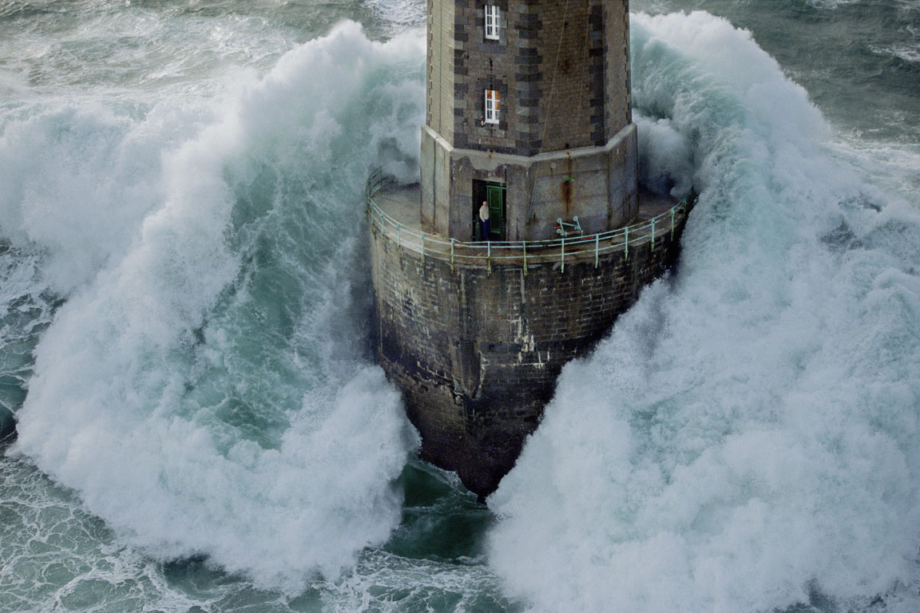
In my secure relationship with God
In the confidence that my life is in God’s hands.
In my constant awareness of his presence made clear as I pray
In the assurance of a final home with him.
The Place of
Peace

Slide 11
Give You
And let the peace of God rule
in your heart – Col 3:15
Peace
You must seek and pursue peace
1 Peter 3:11
You must have a zeal for peace
2 Peter 3:14
“sim (give) indicates the ‘putting’ of a person or object into a new setting for a special purpose that
implies some sort of transformation”

Slide 12
Put my name on the Israelites,
(Characteristic/Personality)
Lift his face and Peace
(Relationship/Wholeness)
Face Shine and Gracious
(Smile/Beautiful to behold)
Bless and keep
(Serve/Protect)

Slide 13
Deuteronomy 26:16-19
Fully obey God and life will be as it should be
Deuteronomy 28:1ff
Disobey and life will be miserable
Deuteronomy 28:15ff

Slide 14
In the law the guilty party repaid the one offended.
In God’s plan, the offended one,
God, makes the payment.
For God was pleased to have all his fullness dwell in him, and through him to reconcile to himself all things, …by making peace through his blood, shed on the cross
Colossians 1:20,21
The result of Salem is Shalom

Slide 15
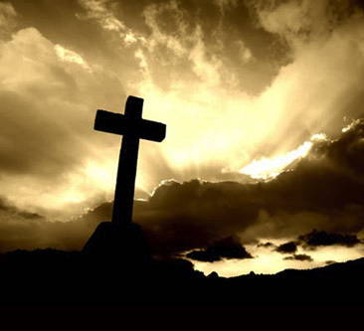
¹⁰ For all who rely on the works of the law are
under a curse, … “Cursed is everyone who does not continue to do everything written in the Book of the Law.” … ¹³ Christ redeemed us from the curse of the law by becoming a curse for us,… ¹⁴ He redeemed us in order that the blessing given to Abraham might come to the Gentiles through Christ…
Galatians 3:10-14

