Slide 1
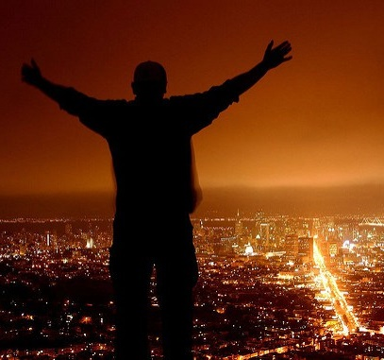
Tell Aaron and his sons, ‘This is how you are to bless the Israelites,
Say to them:
‘The LORD bless you and keep you; the LORD make his face to shine upon you and be gracious to you; the LORD turn his face toward you and give you peace.’
So they will put my name on the Israelites, and I will bless them.
Numbers 6::23-27

Slide 2
FEEDBACK
We need to learn how to love God back.
“How?”
This is love for God: to obey his commands
1 John 5:3
And this is his command: to believe in the name
of his Son, Jesus Christ, and to love one
another as he commanded us
1John 3:23

Slide 3
FEEDBACK
“God moves in a mysterious way.”
“Behind a frowning providence
he hides a smiling face.”

Slide 4
1 - God moves in a mysterious way His wonders to perform; He plants His footsteps in the sea And rides upon the storm.
2- Deep in unfathomable mines Of never failing skill He treasures up His bright designs And works His gracious will.
3 - Ye fearful saints, fresh courage take; The clouds ye so much dread Are big with mercy and shall break In blessings on your head.
4 - Judge not the Lord by feeble sense, But trust Him for His grace; Behind a frowning providence He hides a smiling face.
5 – Blind unbelief is sure to err, and scan his work in vain; God is his own interpreter, and he will make it plain.
https://www.youtube.com/watch?v=AzHL78CttDE

Slide 5
FEEDBACK
William Cowper (1731-1800)
“…the poet addresses comforting words to the fearful, bids them remember their limitations of understanding, and boldly asserts his faith in the goodness of God
in spite of all appearances.”
“The Gospel in Hymns” by Albert Bailey P.133

Slide 6
The Aaronic Blessing
It is our High Priest’s blessing to us
2) It is to be understood personally
3) Blessings are God’s gifts to us
4) Blessings receive their completeness
only when we respond in active faith
5) They include God’s protection and care for us
6) God’s attitude toward his child can be
summed up in a smile – he smiles at you.

Slide 7
Tab enter SONG

Slide 8
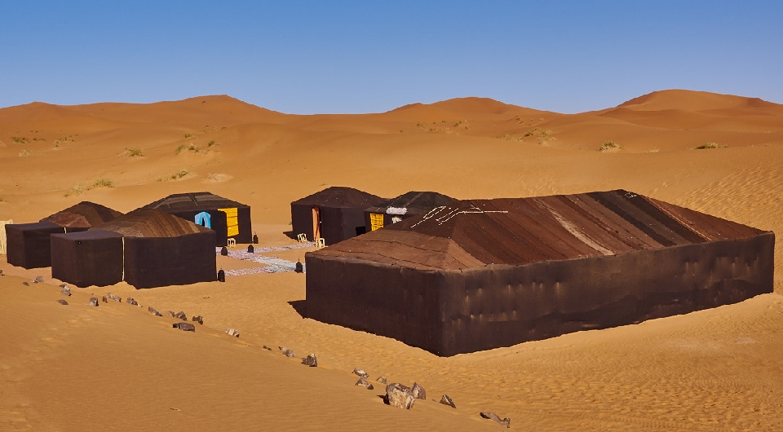
Be Gracious
Hhnan ~ חָנַן
“A sight to behold!”
“Home”
CAMP

Slide 9
Be Gracious
God’s graciousness is
embodied in Jesus
From the fullness of his grace we have all received one blessing after another. For the law was given through Moses; grace and truth came through Jesus Christ
John 1:16,17

Slide 10
Be Gracious
God’s graciousness is
restorative in body, mind and spirit
May God himself, the God of peace, sanctify you through and through. May your whole spirit, soul and body be kept blameless at eh coming of our Lord Jesus Christ. The one who calls you is faithful and he will do it
1 Thessalonians 5:23,24

Slide 11
Be Gracious
God’s graciousness is
summed up in “rest”
Come to me, all you who are weary and burdened, and I will give you rest. Take my yoke upon you nad learn from me, for I am gentle and humble in heart, and you will find rest for you souls.
Matthew 11:28,29

Slide 12
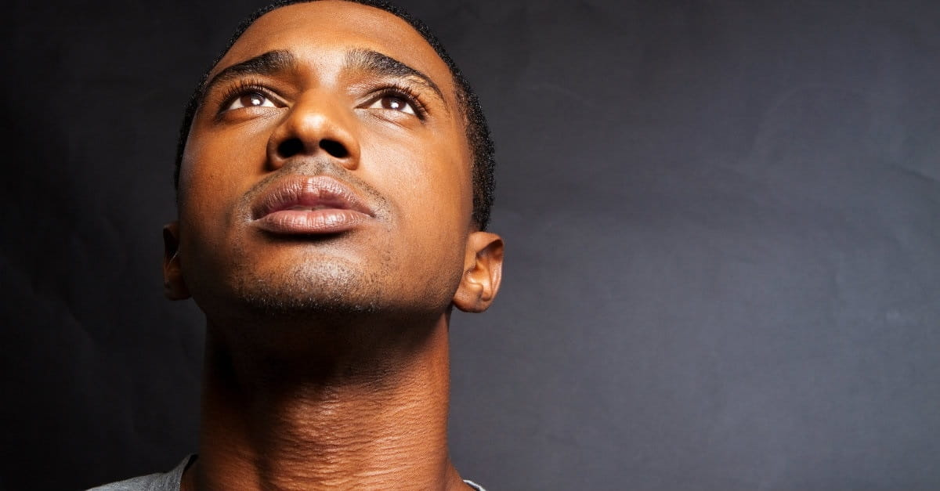
Lift Up His Face
נָשָׂא
Nasah
Carry a burden.
“accept carry, exalt, forgive, pardon, raise” and more.

Slide 13
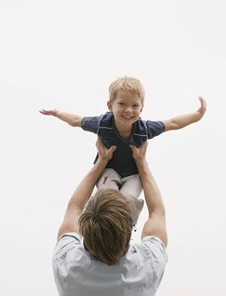
Lift Up His Face
His face “lit up”
Giving your fullest attention to someone

Slide 14
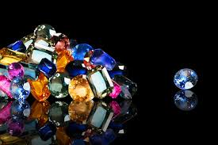
Lift Up His Face
You are a special treasure to God
Out of all the peoples
on the face of the earth, the Lord has chosen you
to be his treasured possession
Deut 14:2
“My Jewel”

Slide 15
Lift Up His Face
Valued, Special, Uniquely my own
You are a special treasure to God
But you are a chosen
people, a royal priesthood,
a holy nation, a people belonging to God
1 Peter 2:9
“My Jewel”

Slide 16
How you deal with your sins exposes how
you view God
How should we respond to God
lifting us up over
his head in love?
Therefore, brothers, since we have confidence to enter the Most Holy Place by the blood of Jesus…let us draw near to God with a sincere heart…
Hebrews 10:19-21

Slide 17
What is God’s response to mankind's rebellion?
The god of this age has blinded the minds of unbelievers, so that they cannot see the light of the gospel of the glory of Christ, who is the image of God. For God, who said, “Let light shine out of darkness,” made his light shine in our hearts to give us the light of the knowledge of the glory of God in the face of Christ.
2 Corinthians 4:4,6

Slide 18
Psalm 67 ~
May God be gracious to us and bless us and make his face shine on us— ² so that your ways may be known on earth, your salvation among all nations.
³ May the peoples praise you, God; may all the peoples praise you.
God’s graciousness, demonstrated in Christ and
given to us through his Spirit should result in
a life transforming into gracious living.

