Slide 1
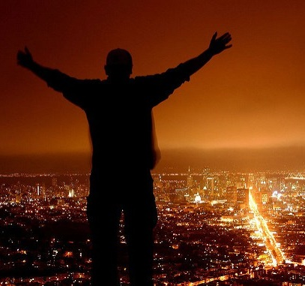
Tell Aaron and his sons, ‘This is how you are to bless the Israelites,
Say to them:
‘The LORD bless you and keep you; the LORD make his face to shine upon you and be gracious to you; the LORD turn his face toward you and give you peace.’
So they will put my name on the Israelites, and I will bless them.
Numbers 6::23-27

Slide 2
Three Keys to understanding the Old Testament
Where is the Golden Rule in this passage?
So in everything, do to others, what you
would have them do to you, for this
sums up the Law and the Prophets.
3 Questions to Ask
3 Questions to Ask
Matthew 7:12

Slide 3
Three Keys to understanding the Old Testament
How does this teach me to love?
Love the Lord you God with all your heart and with all your soul and with all you mind. This is the first and greatest commandment. And the second is like it: Love your neighbor as yourself. All the Law and the Prophets hang of these two commandements.
3 Questions to Ask
3 Questions to Ask
Matthew 22:37-40

Slide 4
Three Keys to understanding the Old Testament
Where is Jesus?
Do not think that I have come to abolish the Law
or the Prophets; I have not come to abolish them
but to fulfill them.
3 Questions to Ask
3 Questions to Ask
Matthew 5:17

Slide 5
Three Keys to understanding the Old Testament
Application: Our righteousness from God
But now a righteousness from God, apart from law,
has been made know, to which the Law and
the Prophets testify. This righteousness from God comes through faith in Jesus Christ to all who believe.
3 Questions to Ask
3 Questions to Ask
Romans 3:21,22

Slide 6
Song

Slide 7
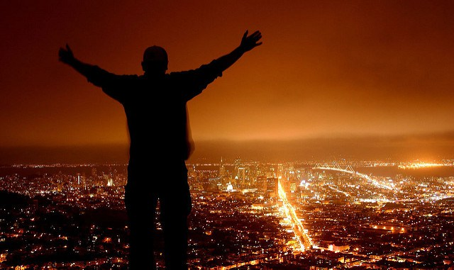
Therefore, since we have a great high priest who has gone through the heavens, Jesus the Son of God, let us hold firmly to the faith we profess
Hebrews 4:14.
The Lord Bless You.
“I bless you and keep you; I shine upon you and am gracious to you;
I lift my face to you and give you my peace.
When he had led them out to the vicinity of Bethany, he lifted up his and blessed them
Luke 24:50

Slide 8
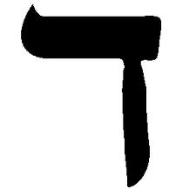
B a R a K
Bless You.
B a R
Bless: It is an act of service – The LORD bless you – the LORD serve you, the LORD kneels before you giving you what you need.
K

Slide 9
Bless - “a good word spoken”
When God speaks a good word, he speaks a loving word, which is a life word.
How does He Bless?
Genesis 1:28 ~ “He blessed them and said …a good word spoken.
“Be fruitful, increase, fill, subdue and rule.”
God’s action in 1:29 – “I give.”

Slide 10
Blessed in our spirits
His divine power has given us everything we need for life and godliness…so that…you may participate in the divine nature
1 Pet. 1:3,4
Ways He Blesses

Slide 11
For it is God who works in you to will and to act according to his good purpose Phil 2:13
Blessed in our thoughts
Ways He Blesses
Finally, brothers, whatever is true, whatever is noble, whatever is right, whatever is pure, whatever is lovely, whatever is admireable 0 if anything is excellent or praiseworthy – think about such things
Philippians 4:8

Slide 12
Blessed in our emotions
Ways He Blesses
Do not be anxious about anything, but in everything,
by prayer and petition with thanksgiving, present your requests to God. And the peace of God, which
transcends all understanding, will guard your
hearts and minds in Christ Jesus
Phil 4:6,7

Slide 13
Blessed in our possessions
Ways He Blesses
Dear friend, I pray that you may enjoy good health,
and that all may go well with you
3 John 1:2

Slide 14
God serves us – kneels before us, humbling himself and extending his hand of grace to us.
He comes with every gift of life, love and goodness.
“If God blesses then why am I anxious,
why do I think wrongly, where are my possessions?
I don’t feel blessed”
Are you humble, (like God) to receive them? Our response is to receive these words in faith – receive the blessing and do something.
WE HAVE TO PUT IT INTO ACTION.

Slide 15
The Lord Bless you and keep you; the Lord make his face to shine upon you and be gracious to you, the Lord turn his face toward you and give you peace.

