Slide 1
Gospel centered life
S3:Episode 1 Wake up

Slide 2
Amos 6
THIS EPISODE WILL DISCUSS THE FOLLOWING topics
COMPLACENCY
PRIDE
A LACK OF FEAR

Slide 3
Amos 6:1-2
Amos 6:4-6
1 Woe to you who are complacent in Zion, and to you who feel secure on Mount Samaria, you notable men of the foremost nation, to whom the people of Israel come! ² Go to Kalneh and look at it; go from there to great Hamath, and then go down to Gath in Philistia. Are they better off than your two kingdoms? Is their land larger than yours?
You lie on beds adorned with ivory and lounge on your couches. You dine on choice lambs and fattened calves. ⁵ You strum away on your harps like David and improvise on musical instruments. ⁶ You drink wine by the bowlful and use the finest lotions,
What sorrow awaits you who lounge in luxury in Jerusalem,^{[a]} and you who feel secure in Samaria! You are famous and popular in Israel, and people go to you for help. ² But go over to Calneh and see what happened there. Then go to the great city of Hamath and down to the Philistine city of Gath. You are no better than they were, and look at how they were destroyed.
How terrible for you who sprawl on ivory beds and lounge on your couches, eating the meat of tender lambs from the flock and of choice calves fattened in the stall. ⁵ You sing trivial songs to the sound of the harp and fancy yourselves to be great musicians like David. ⁶ You drink wine by the bowlful and perfume yourselves with fragrant lotions. You care nothing about the ruin of your nation.^{[b}

Slide 4
Amos 6:8
⁸ The Sovereign Lord has sworn by himself—the Lord God Almighty declares:
“I abhor the pride of Jacob and detest his fortresses; I will deliver up the city and everything in it.”

Slide 5
Crescendo of wrath
1
2
3
³ You put off the day of disaster and bring near a reign of terror.
⁷ Therefore you will be among the first to go into exile; your feasting and lounging will end.
¹¹ For the Lord has given the command, and he will smash the great house into pieces and the small house into bits.
¹⁴ For the Lord God Almighty declares, “I will stir up a nation against you, Israel, that will oppress you all the way from Lebo Hamath to the valley of the Arabah.”

Slide 6
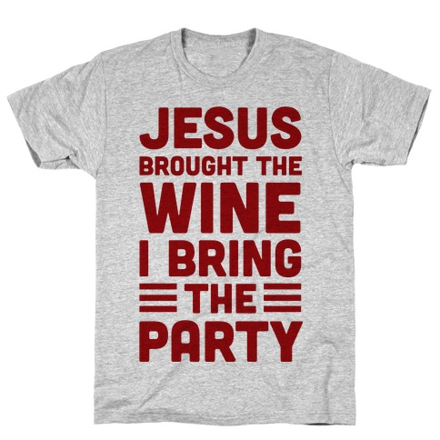
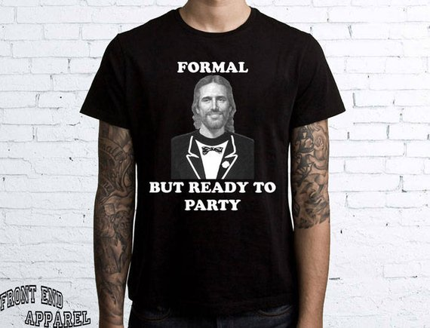
Halloween Christians
vs

Slide 7
complacency
HIDE
STAGNANT
forgetful
PROFESSIONS
Money
relationships
No productive activity
Sluggish
Identity
The cause
Where we come from

Slide 8
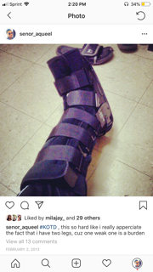
Pride
Self absorbed
Self sufficient

Slide 9
Same God today and same god as yesterday
Romans 2:8-11
⁸ But for those who are self-seeking and who reject the truth and follow evil, there will be wrath and anger. ⁹ There will be trouble and distress for every human being who does evil: first for the Jew, then for the Gentile; ¹⁰ but glory, honor and peace for everyone who does good: first for the Jew, then for the Gentile. ¹¹ For God does not show favoritism.

Slide 11
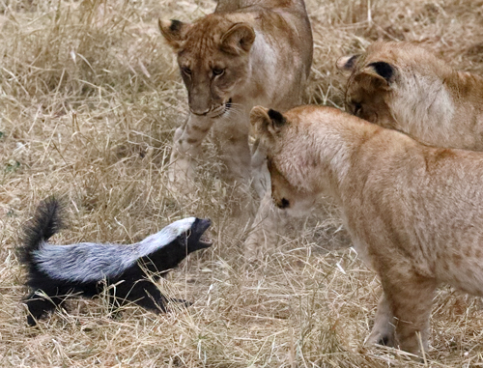
Lack of fear
Deaf to the truth
Misinformed
Rejected

Slide 12
wake up
Stop sleeping on our salvation
Stop sleeping on the world
Stop sleeping on God

