Slide 1
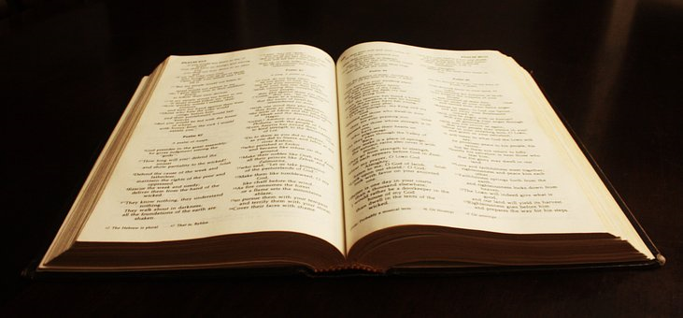
What the Bible Says About Worship

Slide 2
WORSHIP
From…
Acknowledgement
Acceptance
Admiration
Adoration
WORSHIP

Slide 3
WORSHIP
Our personal worship
and our assembly times together

Slide 4
WORSHIP
“Worship” Rom. 12: 1
Service and devotion to someone or something we respect.
Reverence and paying homage or tribute.
Something to which we give time, energy, and emotion.
Something we believe will have personal benefit as a family or as a group.

Slide 5
To worship God is to believe that he is the creator of the universe and of the world.
He is a personal God who desires to have a relationship with mankind (his creation).
He reached out to fallen man to restore a broken relationship that was severed, because of our sin.

Slide 6
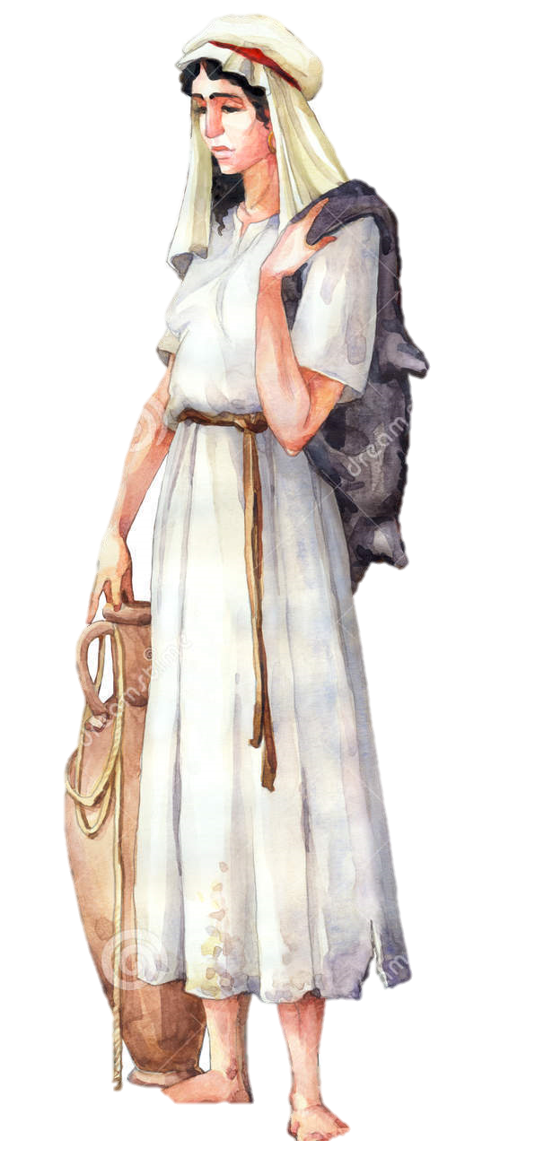
Acknowledgment of Jesus’ Power
John 4:7-10
She addressed him, first, as a Jew.
Jews and Samaritans didn’t associate with each.
She was thinking on earthly things…Jesus helped her see and think in the spiritual dimension---
Location of Worship v. Life Worship
Temporary water v. Living water
She then makes a request for this eternal, lasting water;
V. 11-15 (she moves from acknowledgement to acceptance).

Slide 7
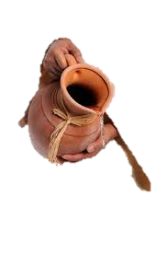
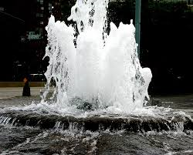
Acceptance of Jesus
Forgiveness and A New Start
Facing our sin and accepting the consequences v. 16-18
Seeing Christ as the only real answer to our sin problem, v 19-20.
Accepting forgiveness and a new direction from God v. 21-24.
That he is the Messiah--the one who came to redeem the world. V. 25-26.

Slide 8
Our Whole Life Worship
Unlike the woman at the well, we worship what we know…
We Worship in Spirit and in Truth

Slide 9
We Worship in Spirit and in Truth
Spirit
God is not confined by things, circumstances, time, space
or location (Mount Gerizim or Mount Zion).
He overpasses all limits.
Therefore, we worship him in spirit—the highest part of who we are—that which lasts beyond the physical:
Love
Loyalty
Devotion
Obedience Zion)not confined to physical space, time, or location
(Mount Gerizim or Mount Zion).

Slide 10
We Worship in Spirit and in Truth
Truth
The total of God’s word—not in part.
This truth founded on LOVE and KNOWLEDGE revealed through the word.
We respond to this spiritual truth out of our knowledge, love and gratitude for what we KNOW he has done for us—not out of ignorance and fear.

Slide 11
Admiration of his Deity
She went back to town and told everyone that she had met Christ and all the details of that encounter ! V. 28-30
They began to believe, based on the enthusiasm and passion of her testimony alone.

Slide 12
Adoration and Willingness to Embrace Christ
The people in the town began to express belief in Christ first, based on what she told them, later… v.39-42
They believed in him, personally, as Savior of the world
because…
they spent time with him themselves
they heard him, personally, for themselves
they came to a personal, individual belief

Slide 13
As the woman at the well, when we meet and come to know Christ, we will…
Acknowledge Accept
Admire Adore
We will be moved to give our lives in worship to him.
Our individual whole-life worship, when brought together with other brothers and sisters, on Sundays, Wednesdays, and in other gatherings, should be like a torch or a bright light shining against a deep, dark sky !

Slide 14
Our Whole Life Worship
Rom. 12: 1-2 God expects us to be transformed into his likeness, to be different from those around us.
It requires a daily sacrifice of self, replacing self with Christ.
So, the next time someone asks about where you worship;
what will you say?

Slide 15
Our Whole Life Worship
Hopefully the answer will be…
“I worship God by the way I live everyday, 24-7-365, but I get to assemble , collectively, with other worshippers at the Central Church of Christ at 407 East Clinton Avenue in Huntsville”.

Slide 16
WORSHIP
Our personal worship
and our assembly times together

