Slide 1
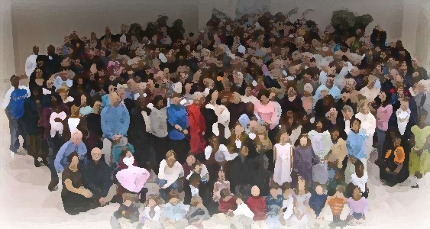
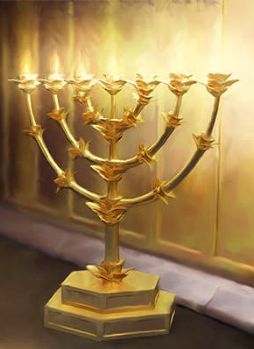
The Lampstand
at Central
Laodicea
Jesus: The final Word
Revelation 3:14-15

Slide 2
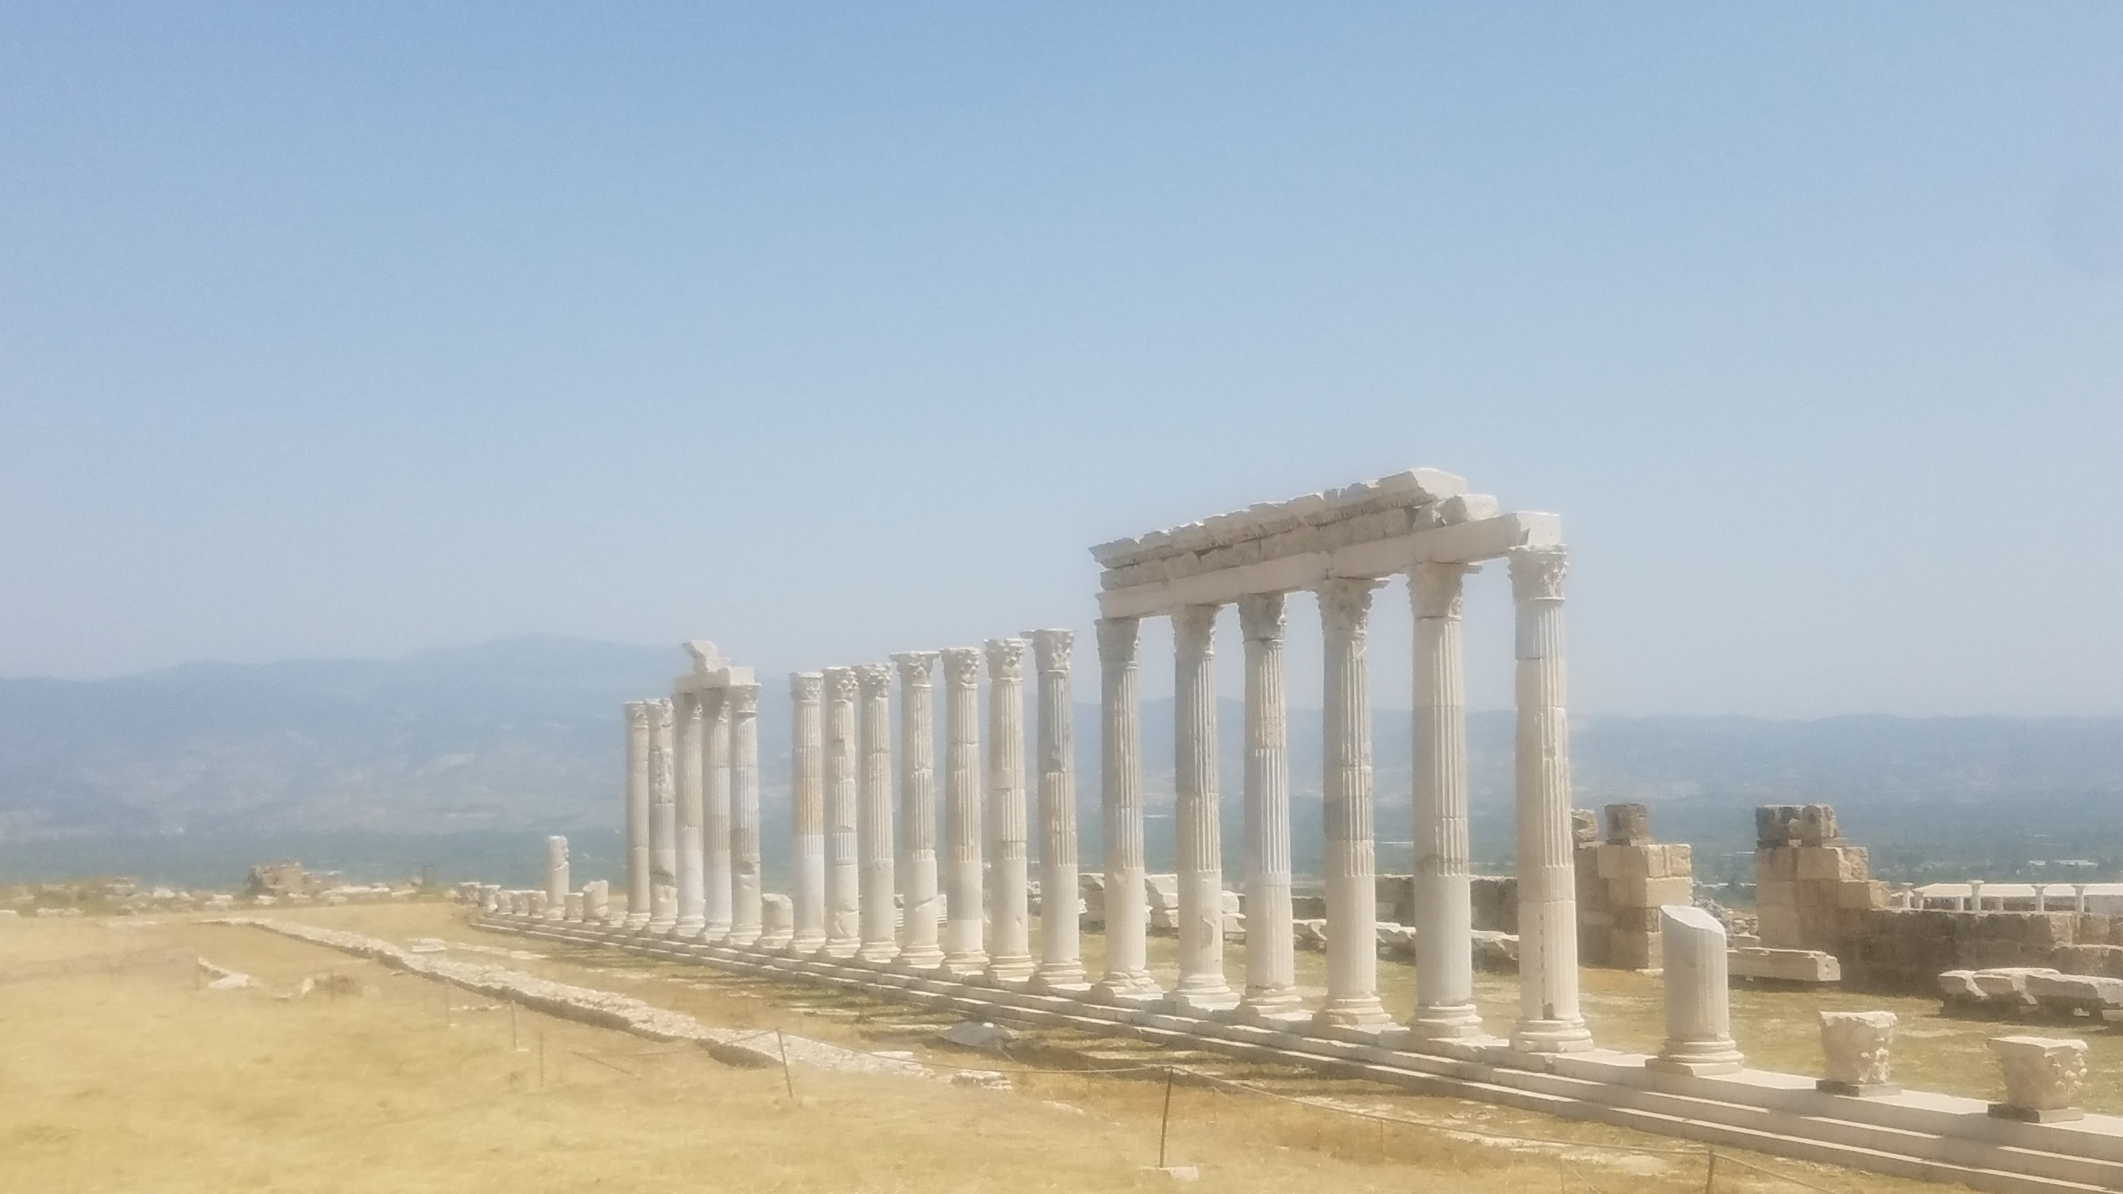
Laodicea
Background of the city supplies the “echoes” for better understanding and application.
Scripture “echoes” & cultural “echoes”

Slide 3
Video - Overview of Laodicea

Slide 4
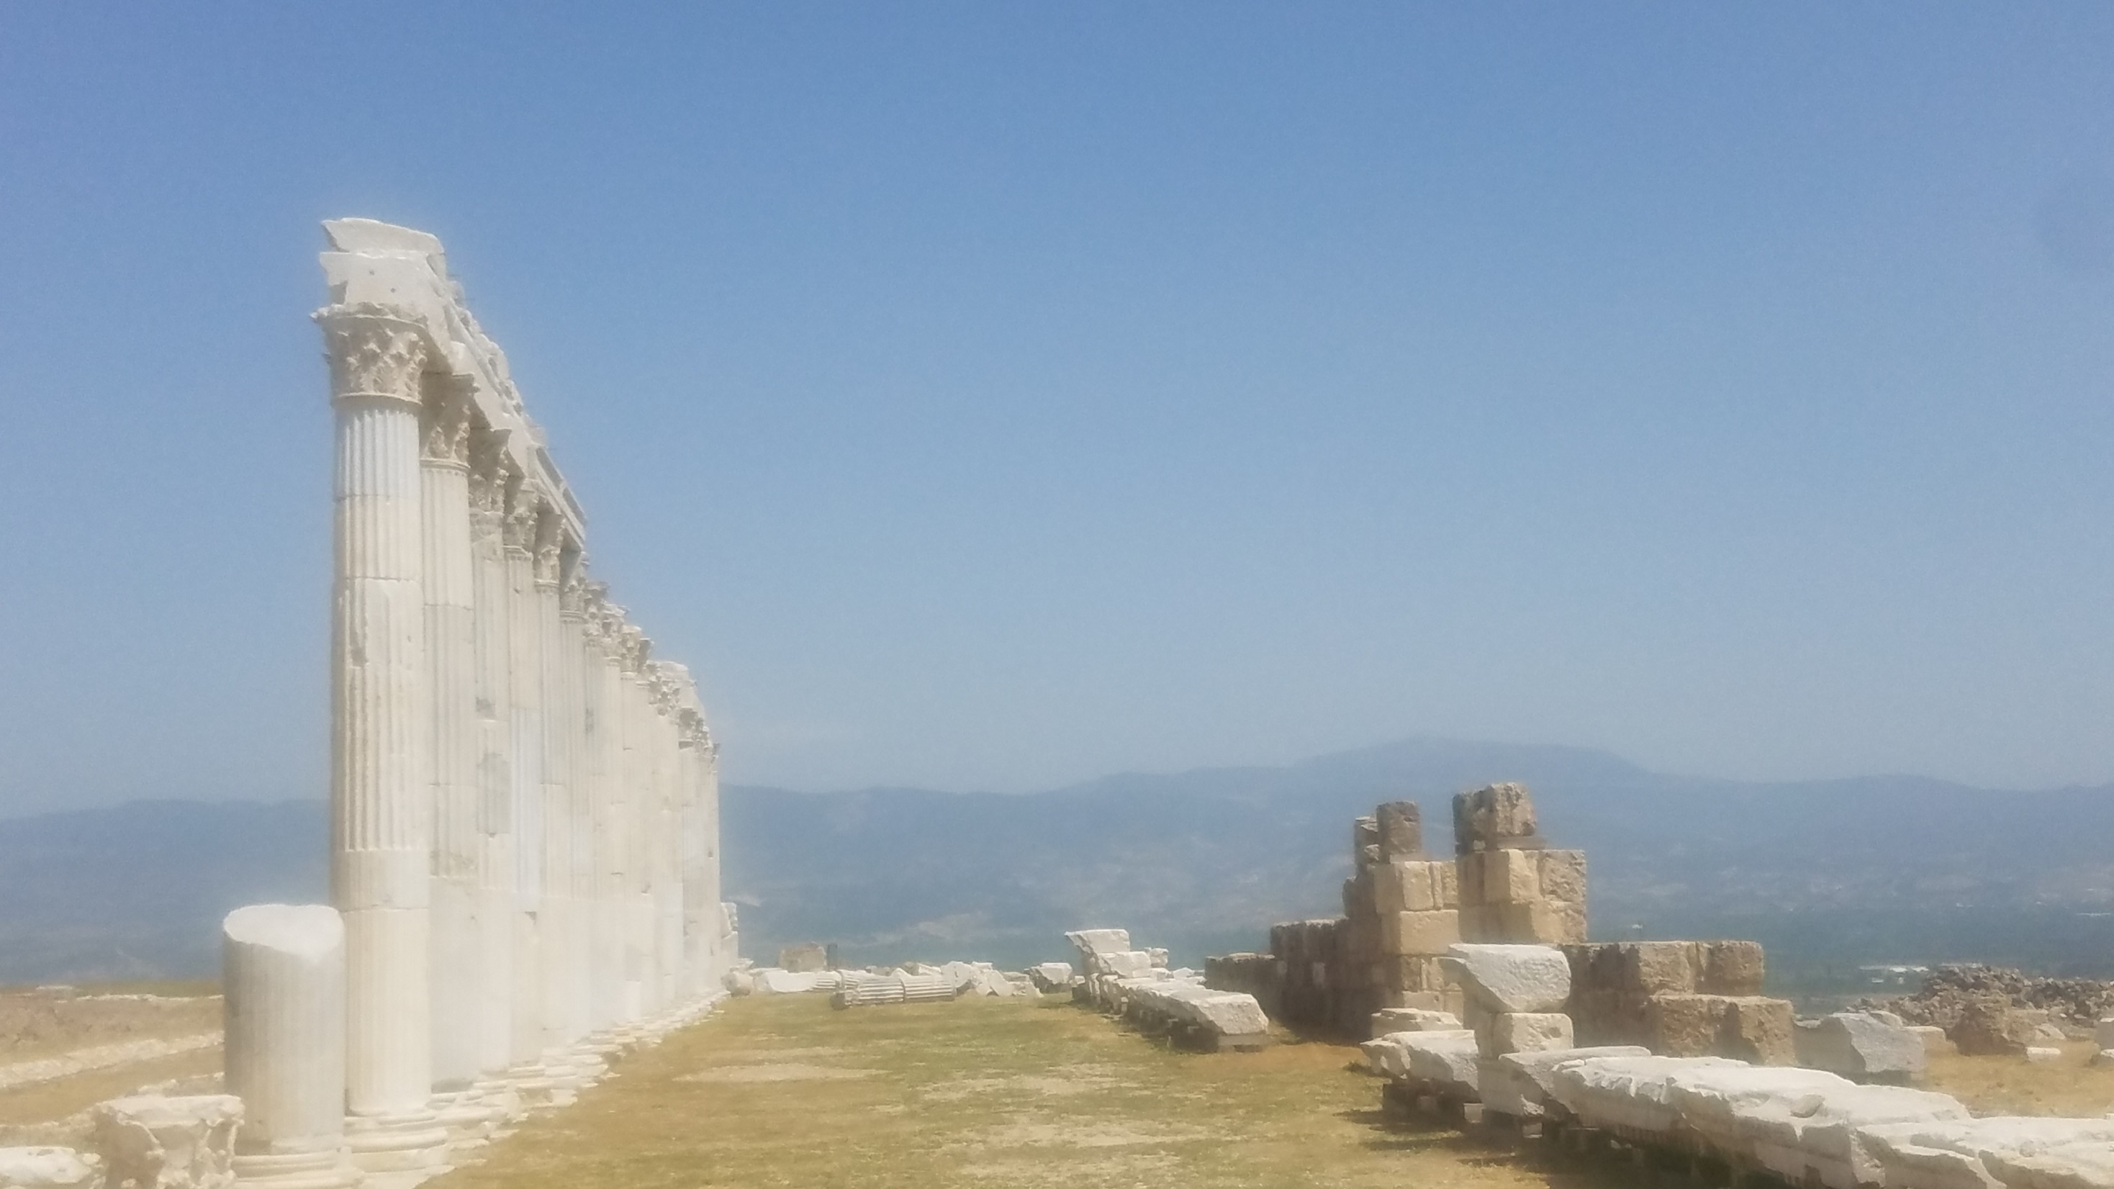
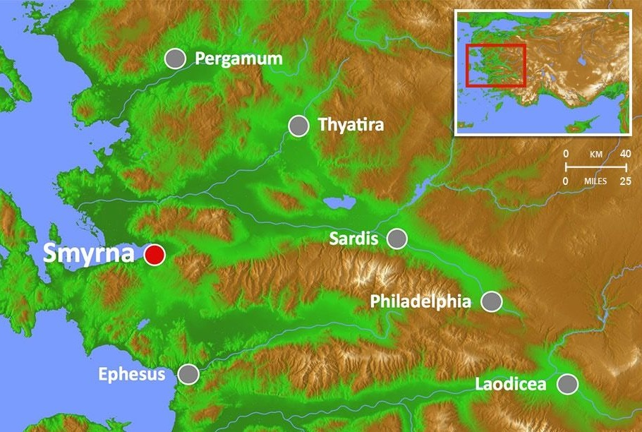
Laodicea
Major Crossroads
Wealthy
Glossy Black-wool sheep
Most secular “democratic” city
Medical Center
Laos – people
Dike - rule

Slide 5
Perfect spot

Slide 6
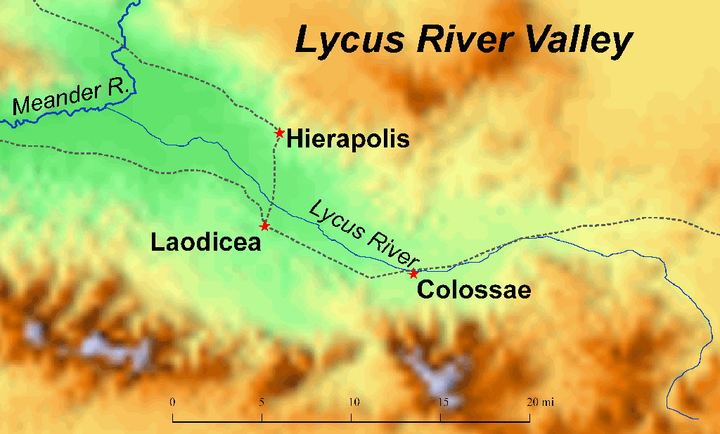
COLOSSAE

Slide 7
VIDEO – Colossae

Slide 8
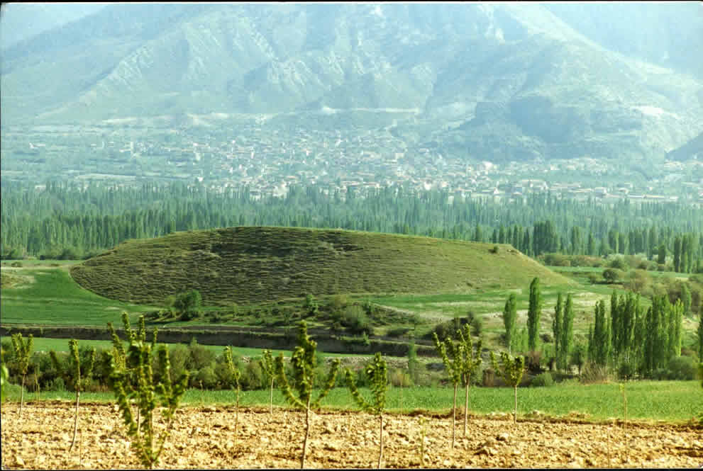
COLOSSAE
Epaphras the founder
Connection with Laodicea

Slide 9
Video Nympha House

Slide 10
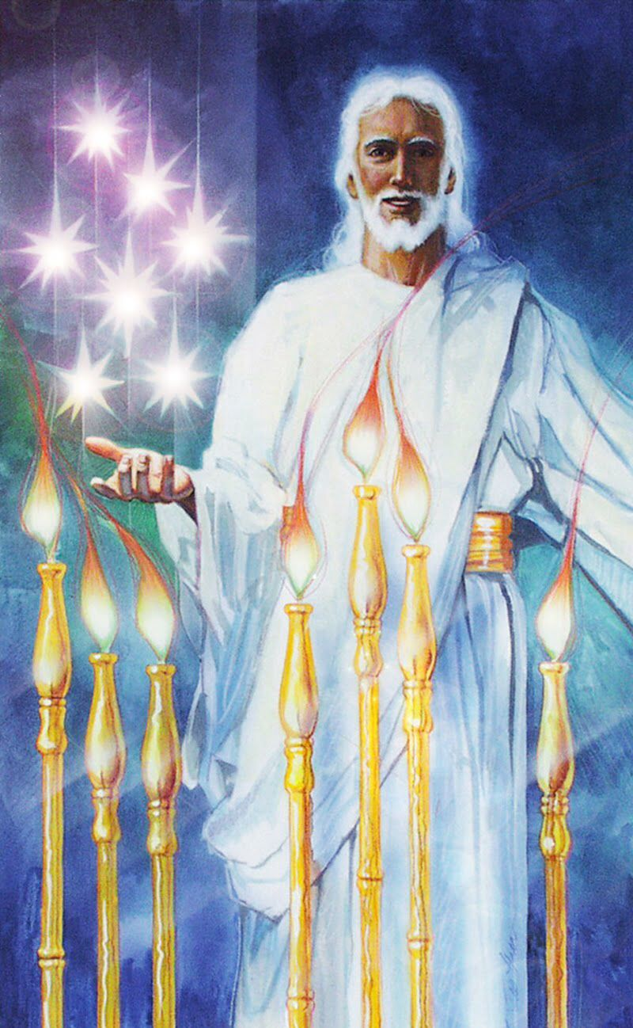
Amen:
Final Truth
Faithful and True Witness:
What he says is the truth
Ruler of God’s Creation: Creator/King
“I am the final word, my word ends all arguments. You can trust me for I will lay everything out faithfully and truthfully. No one can oppose me because I rule heaven and earth.”

Slide 11
What is your excuse
for not listening to Jesus?

