Slide 1
What Is Your Ultimate Goal In Life?

Slide 2
1. God’s will is not as complicated as we make it out to be.
1 Thess. 5:16-18
Rejoice always, pray continually, give thanks in all circumstances; for this is God’s will for you in Christ Jesus.

Slide 3
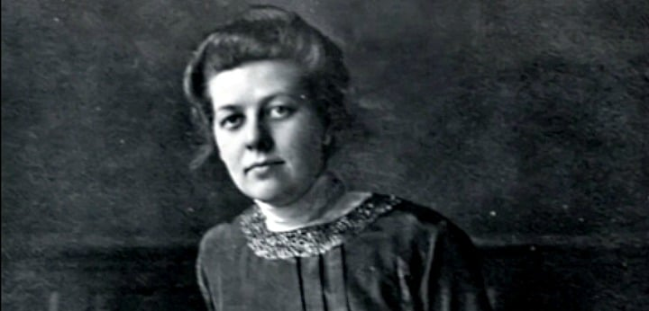
“The fleas! This was too much. ‘Betsie, there’s no way even God can make me grateful for a flea.’
“‘Give thanks in all circumstances,’ she quoted. It doesn’t say, ‘in pleasant circumstances.’ Fleas are part of this place where God has put us.”
- Betsie ten Boom

Slide 4
2. I’ve learned to ask for discernment of scripture at the pace God wants to reveal it to me.
James 1:5
If any of you lacks wisdom, you should ask God, who gives generously to all without finding fault, and it will be given to you.
Proverbs 2:6
For the Lord gives wisdom; from his mouth come knowledge and understanding.
Proverbs 9:10
The fear of the Lord is the beginning of wisdom, and the knowledge of the Holy One is understanding.

Slide 5
3. READ YOUR BIBLE!
2 Timothy 3:16-17
All scripture is God-breathed and is useful for teaching, rebuking, correcting and training in righteousness, so that the servant of God may be thoroughly equipped for every good work.
Hebrews 4:12
For the word of God is alive and active. Sharper than any double-edged sword, it penetrates even to dividing soul and spirit, joints and marrow; it judges the thoughts and attitudes of the heart.
Matthew 24:35
Heaven and earth will pass away, but my words will never pass away.

Slide 6
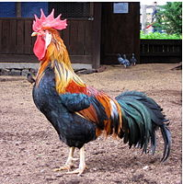
It’s Our Responsibility!

Slide 7
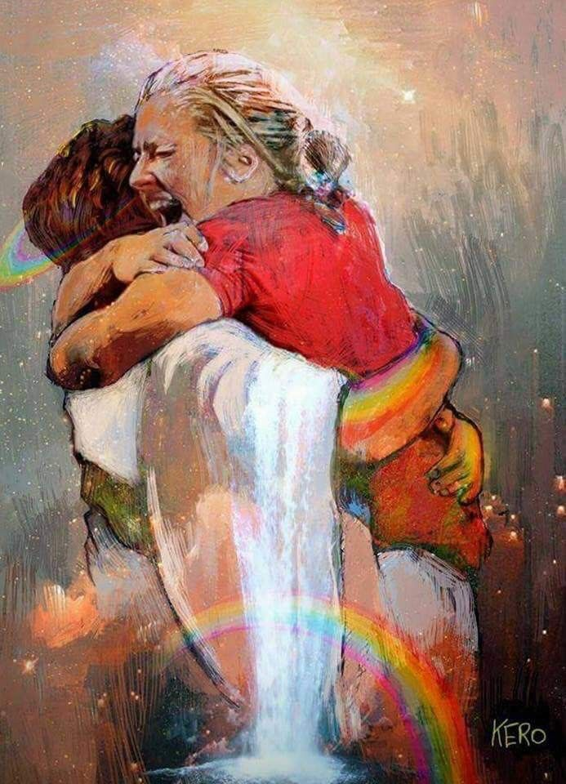
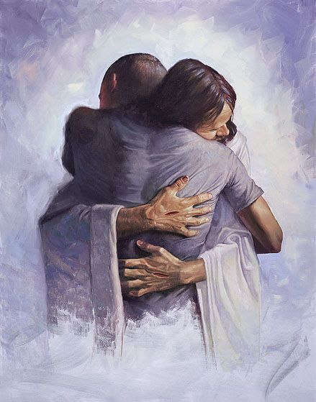
Isaiah 55:8-9
“For my thoughts are not your thoughts, neither are your ways my ways,” declares the Lord. “As the heavens are higher than the earth, so are my ways higher than your ways and my thoughts than your thoughts.”

Slide 8
Romans 6:3-4
Or don’t you know that all of us who were baptized into Christ Jesus were baptized into his death? We were therefore buried with him through baptism into death in order that, just as Christ was raised from the dead through the glory of the Father, we too may live a new life.
What Is Your Ultimate Goal In Life?

