Slide 1
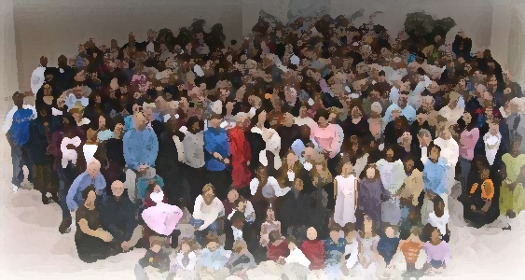
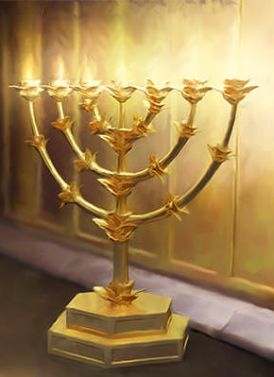
The Lampstand
at Central
Sardis – How to wake up!
Revelation 3:1-6

Slide 2
“You have a reputation – Alive!
But here’s the stark truth – Dead!
“Wake up!”
“…the firstborn from the dead” (1:5)
“I am the Living One, I was dead, and behold I am alive for ever and ever! And I hold the keys
of death and Hades” (1:18)

Slide 3
VIDEO 006 life in a dead church

Slide 4
How can you know?
It is possible that you can be unaware that you are dead spiritually.
“But he did not know that the Lord had left him.” Judges 16:20
Do not put out the Spirit’s fire
1 Thess. 5:19

Slide 5
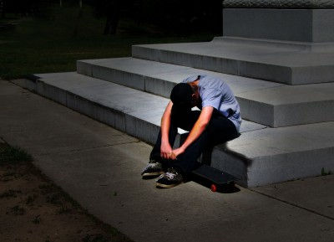
Symptoms of Spiritual Death
What’s growing in my life?
Heb. 6;7,8
What accompanies my walk? Heb. 6:9,10
From the letter to the Hebrews
Am I diligent?
Heb. 6:11, 12
How focused am I on Jesus?
Heb. 12:2

Slide 6
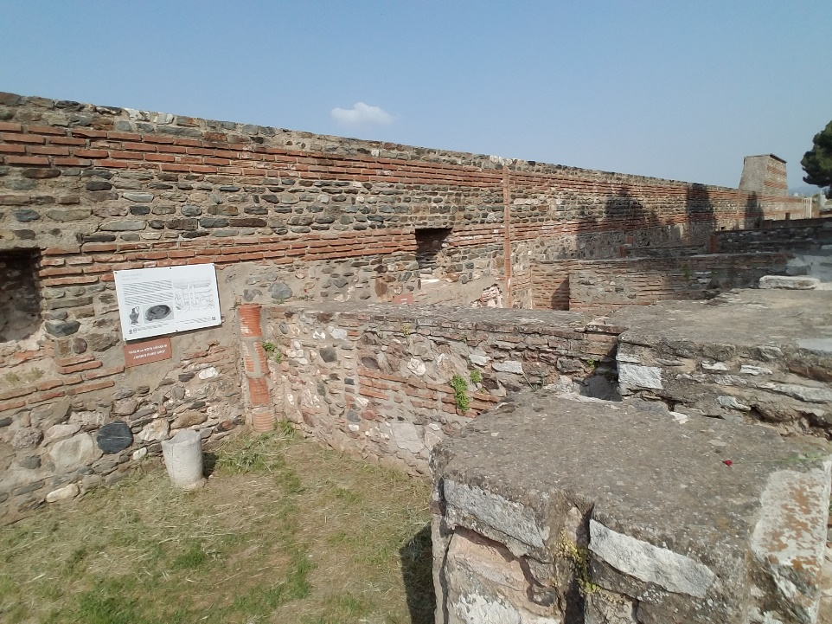
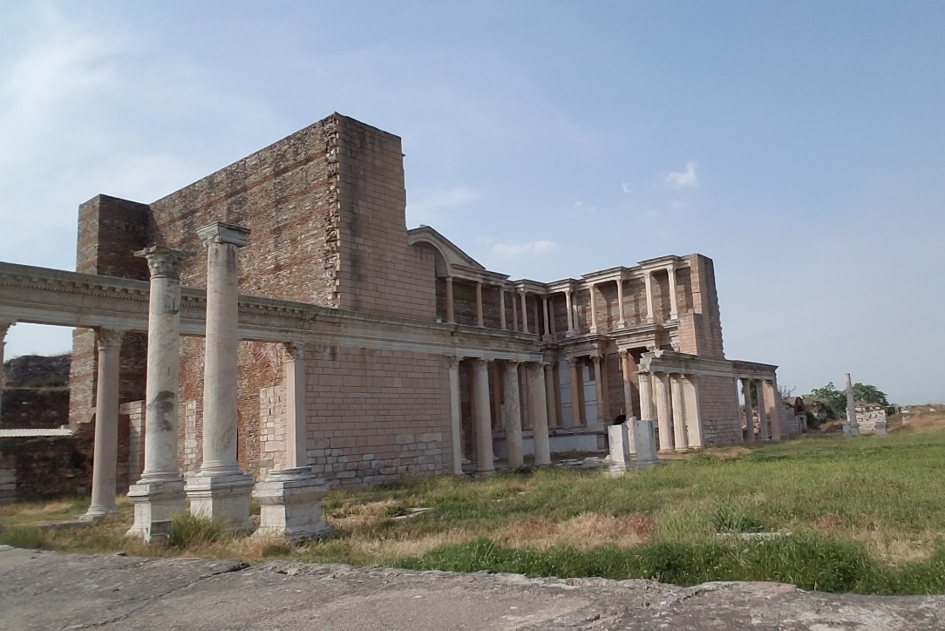
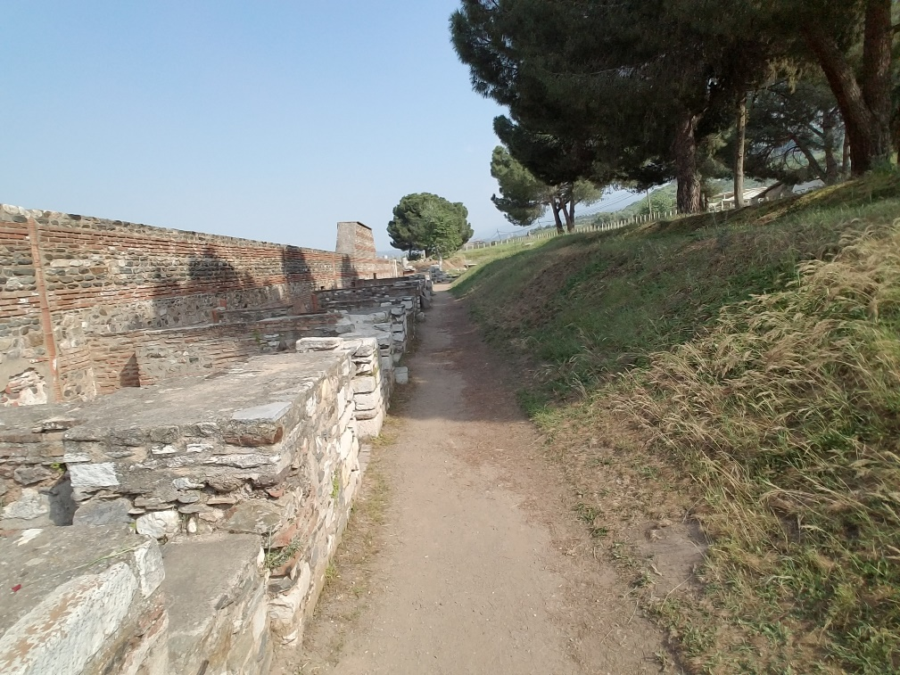
Sardis – a church that blended in with the city
“Get along, don’t rock the boat,
live and let live”

Slide 7
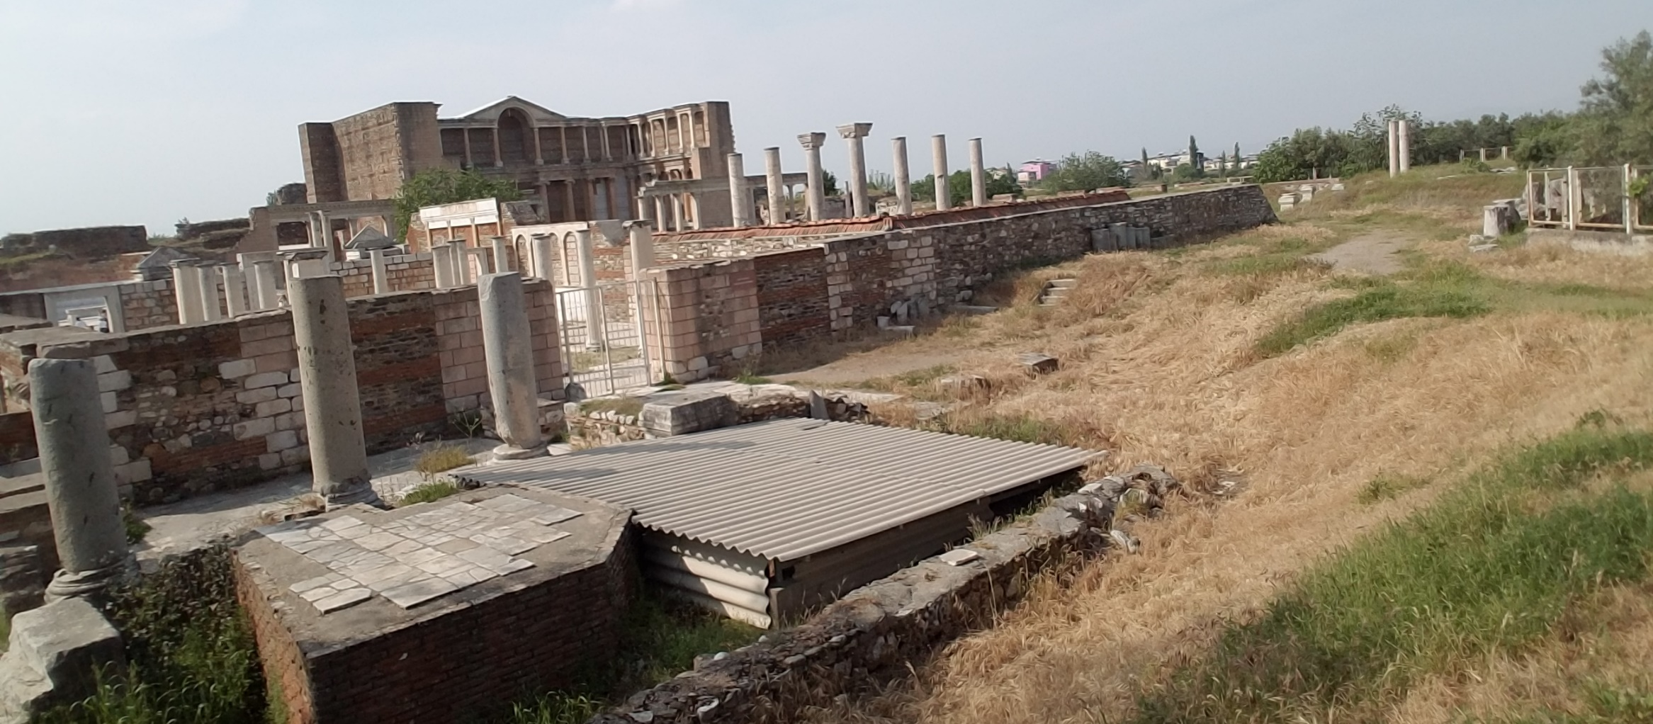
What Christ told them to do
“WAKE UP!”
Don’t fall back asleep

Slide 8
What Christ told them to do
STRENGTHEN!
HOW?
Make a determined decision
You strengthen yourself by eating and drinking.
“I am the bread of life; I am the living water.”
“I have not found your deeds complete”
“fulfilled”

Slide 9
What Christ told them to do
STRENGTHEN!
“You have not fulfilled your purpose.”
Your purpose is to be filled up!
With the Spirit (Eph. 5:18)
With “the fruit of righteousness that comes
from Jesus Christ (Phil 1:11)
Your ultimate fulfillment is to glorify God in all you do (Col.3:17)

Slide 10
What Christ told them to do
REMEMBER!
Keep on
doing this!
Recalling the centrality of the life, death, burial and resurrection of Jesus
(1 Cor 15)
In the forefront of your thinking.
What do you think about all day long?

Slide 11
What Christ told them to do
OBEY!
Keep on
doing this!
“Keep”
Guard, protect, watch over
Application: Not enough to remember without doing

Slide 12
What Christ told them to do
REPENT!
Make a determined decision!
A change of mind that leads to a change of thinking that leads to a change of life direction.

Slide 13
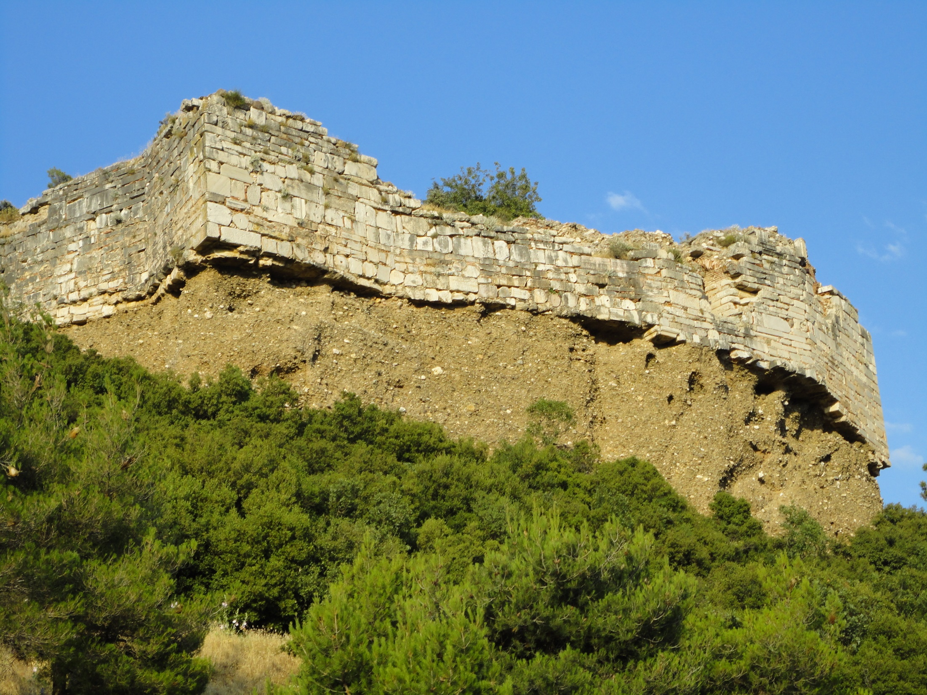
Do you remember how your walls were breeched?
It will happen again if you don’t stay awake.

Slide 14
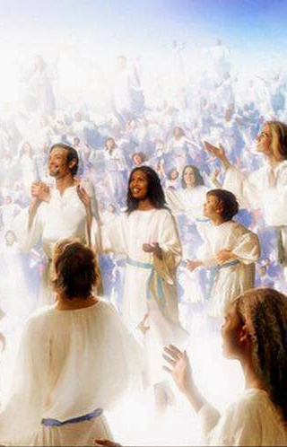
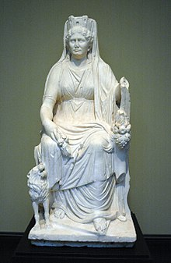
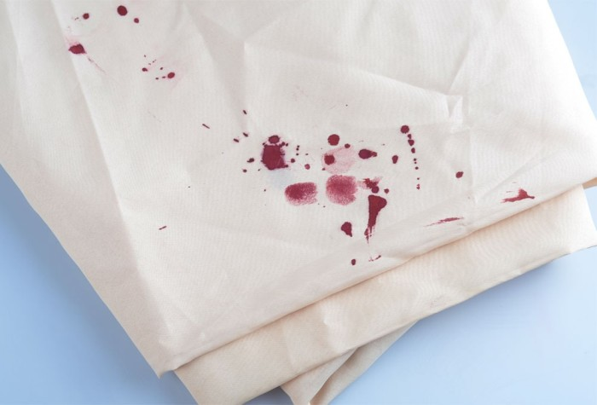
Encouragement:
Some without soiled clothes
Stay close to Christ: your focus, what is in the forefront of your mind.
Cybele & blood-stained clothes

Slide 15
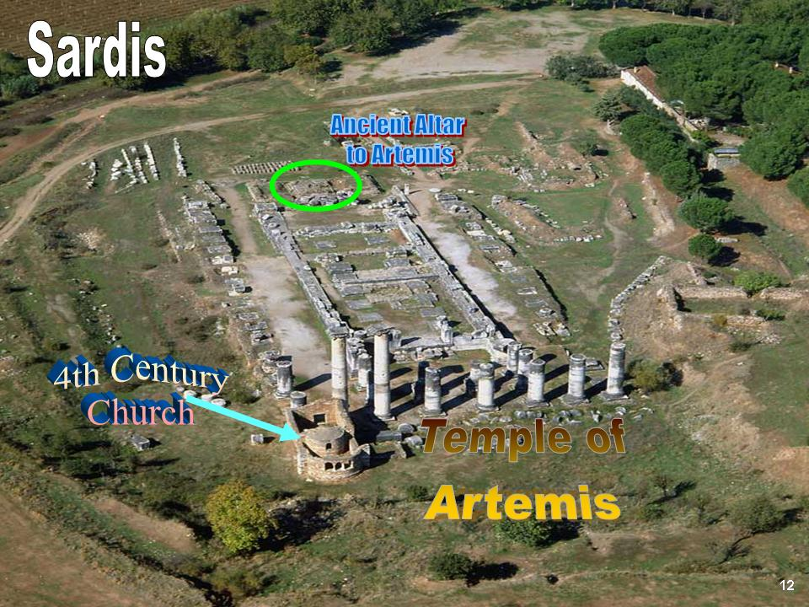
How did this church do? Did they stay awake?
Did they repent?

Slide 16
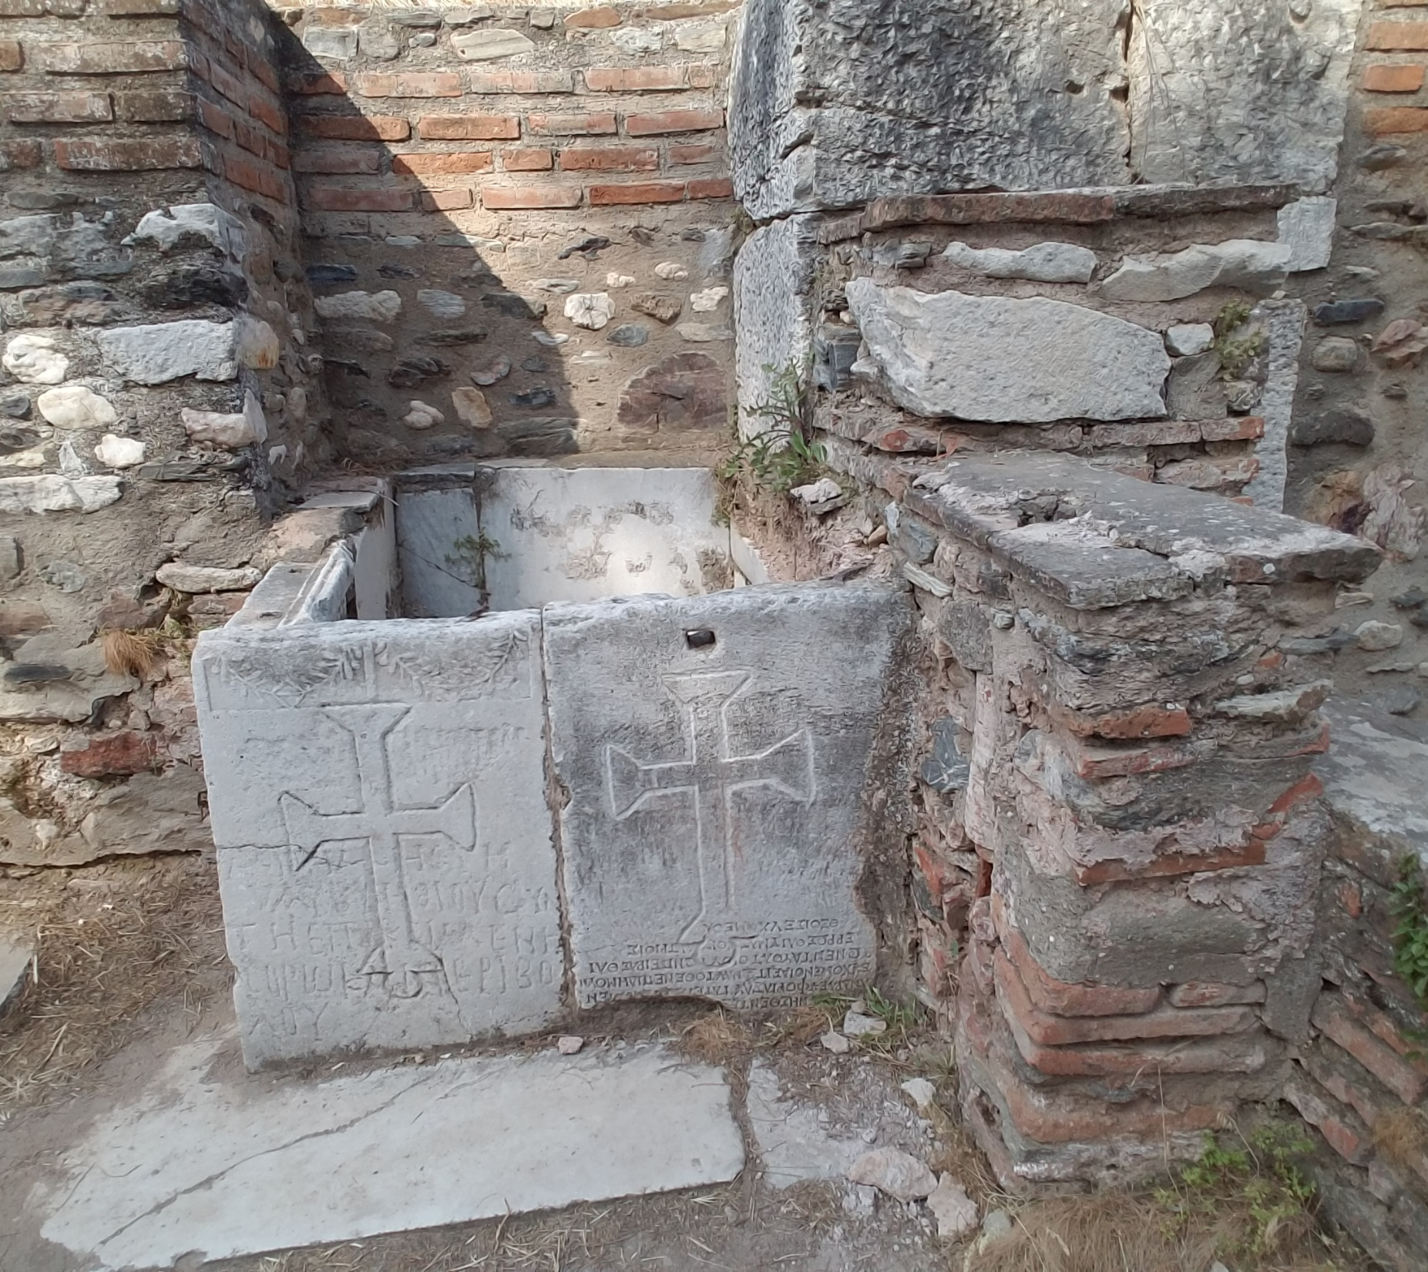
How did this church do? Did they stay awake?
Did they repent?

Slide 17
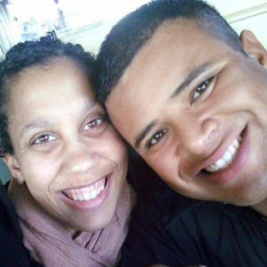
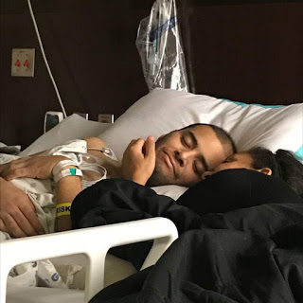
Kimberli & Melchor
Why the church doesn’t need anymore coffee bars
March 8, 2017

