Slide 1
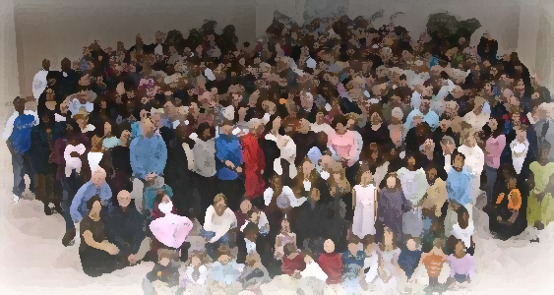
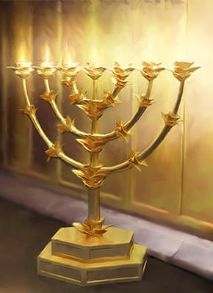
The Lampstand
at Central
Living in the Fear of the Lord
Revelation 1:17-20

Slide 2
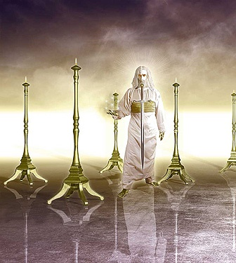
What is God trying to tell us?
Christ is Judge
“As for the person who hears my words but does not keep them, I do not judge him. For I did not come to judge the world but to save it. There is a judge for the one who rejects me and does not accept my words; that very word which I spoke will condemn him at the last day.” John 12:47.48

Slide 3
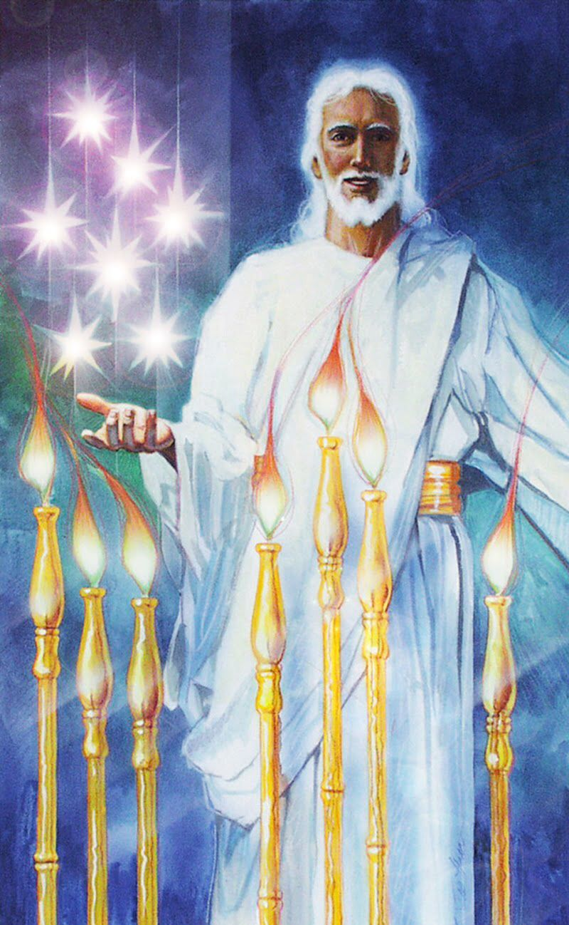
Seven Stars
The angels of the seven churches
Heavenly Angels?
Angels mean “messengers”
A particular leader, preacher, elder?
The person bringing the letter?
The “reader/messenger”
in each church

Slide 4
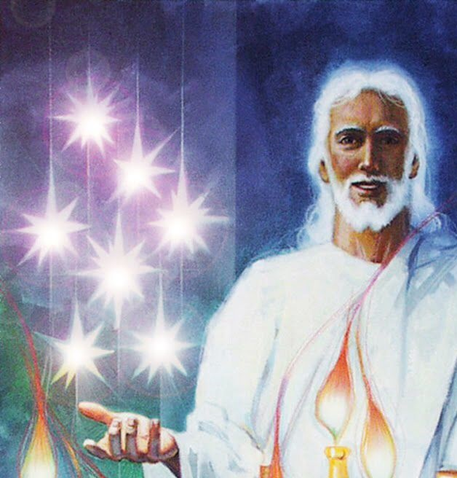
Christ holds the church, the faithful people of God in his right hand and no one can remove them
My sheep listen to my voice; I know them, and they follow me. I give them eternal life, and they shall never perish; no one can snatch them out of my hand.
My Father, who has given them to me, is greater
than all; no one can snatch them out of my
Father’s hand. I and the Father are one.
John 10:27-30

Slide 5
Our encounter with God. 17a, 19
A reaction and a command
Awful
Awesomeness
to God
Reaction:
“Fell as if dead”
Command:
“Write…”

Slide 6
God’s encounter with you 17b-20
“Was dead
but
now alive”
“Keys of dead and Hades”
God touches
“He placed his right hand on me…”
“I am the First and the Last”
“Don’t
be
afraid”

Slide 7
A Choice: Fear of God or Afraid-ness of God
Context determines meaning
“Awe, reverence”
“Do not be afraid”
“Fear God”
“Physical terror or afraid”

Slide 8
Can we live without afraid-ness
yet live in the fear of the Lord?
The fear of the Lord is the beginning of wisdom,
and knowledge of the Holy One is understanding
Proverbs 9:10

Slide 9
The Spirit of the Lord will rest upon him –
the Spirit of wisdom and of understanding,
the Spirit of counsel and of power,
the Spirit of knowledge
and of the fear of the Lord –
and he will delight in the fear of the Lord
Isaiah 11:2,3

Slide 10
Afraid-ness of God may keep me from doing bad things but fear of God not only keeps me from sin but motivates me to be good. Afraid-ness is negative motivation, fear of God is positive motivation
For you did not receive a spirit that makes you a slave again to fear, but you received the Spirit of sonship. And by him we cry, “Abba, Father.” The Spirit himself testifies with our spirit that we are God’s children.
Romans 8:15,16

