Slide 1
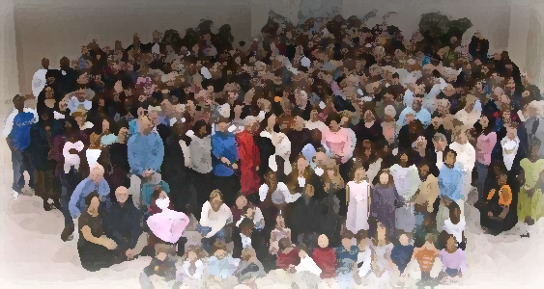
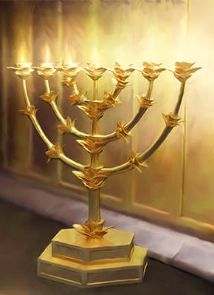
The Lampstand
at Central
The Christ in Glory
Revelation 1:12-16

Slide 2
Revelation is more about
Christ than the future; more about Christ than the church; more about Christ than our struggles.
Christ
Centered
Message
Is Christ worthy?
Two motivations – fear or love.
Fear – (Afraid-ness)
Love – (Esteem)

Slide 3
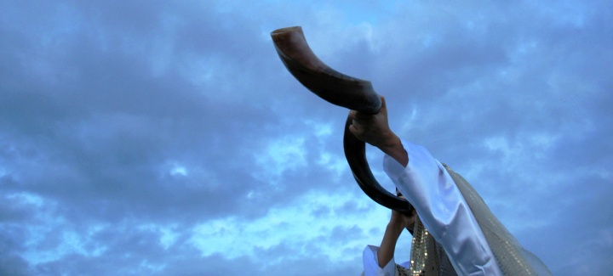
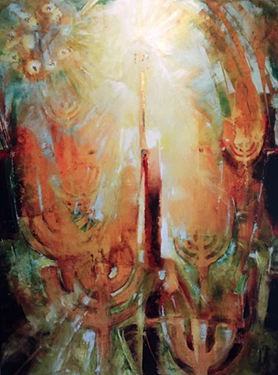
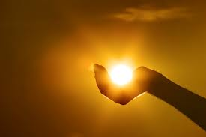
Announcing the presence and communication from God.
Voice like (v.10)
The
Vision
Trumpet
Seven golden lampstands with Christ in the middle of them.
you are the light of
the world…

Slide 4
The
Vision:
Christ
The
Wonder
And he will be called Wonderful (a Wonder!) Counselor, Mighty God, Everlasting Father,
Prince of Peace.
Isaiah 9:6

Slide 5
The
Vision:
Christ
The
Wonder
You are beautiful beyond description, too marvelous for words, too wonderful for comprehension, like nothing ever seen or heard. Who can grasp your infinite wisdom? Who can fathom the depth of your love? You are beautiful beyond description. Majesty, enthroned above.
And I stand, I stand, in awe of you (2)
Holy God to whom all praise is due
I stand in awe of you

Slide 6
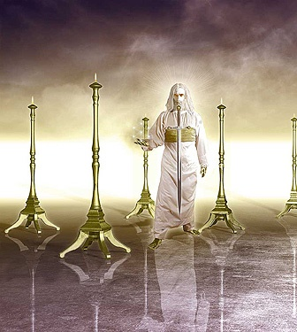
The
Vision:
Christ
The
Symbols
Like a son of man
…there before me was one like a son of man Daniel 7:13,14
And he (the Father) has given him (Jesus) authority to judge
because he is a son of man.
John 5:27

Slide 7
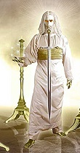
Robe:
Priest/Judge
The
Vision:
Christ
The
Symbols
For he has set a day when he will judge the world with justice by the man he has appointed. He has given proof of this to all men by raising him from the dead.
(Acts 17:30)

Slide 8
Head and Hair:
Purity/Wisdom
The
Vision:
Christ
The
Symbols
Though your sins are like scarlet, they shall be as white as snow; though they are red as crimson, they shall be like wool.
Isaiah 1:18

Slide 9
Eyes
He sees perfectly
The
Vision:
Christ
The
Symbols
Nothing in all creation is hidden from God’s sight. Everything is uncovered and laid bare before the eyes of him to whom we must give account.
Heb. 4:13

Slide 10
Feet
Holy Strength
The
Vision:
Christ
The
Symbols
Then you will trample down the wicked; they will be ashes under the soles of your feet on the day when I do these things
Malachi 4:3

Slide 11
https://www.youtube.com/watch?v=a0c70cD8o9U
The
Vision:
Christ
The
Symbols
Voice
Might/Majesty
Mightier than the thunder of the great waters, mightier than the breakers of the sea the Lord on high
is mighty.
Psalm 93:4

Slide 12
Right hand:
Strength/Favor
The
Vision:
Christ
The
Symbols
The Lord’s right hand has cone mighty things! The Lord’s right hand is lifted high; the Lord’s right hand has done mighty things!
Ps. 118:15,16

Slide 13
Mouth
Strength/Favor
The
Vision:
Christ
The
Symbols
He made my mouth like a sharpened sword,
in the shadow of his hand he hid me;
Isaiah 49:2
The word of God
is sharper than a two-edged sword
Heb. 4:12

Slide 14
Face
Sum of his character
The
Vision:
Christ
The
Symbols
The Son is the radiance of God and the
exact representation
of his being…
Heb. 1:3:2
…give us the light of the knowledge of the glory of God in the face of Christ
2 Cor. 4:6

Slide 15
Holy Lord, most Holy Lord
You alone are worthy of my praise
O Holy Lord most Holy Lord
With all of my heart I sing
Great are you Lord
Worthy of praise
Holy and true
Great are you Lord
Most Holy Lord

