Slide 4
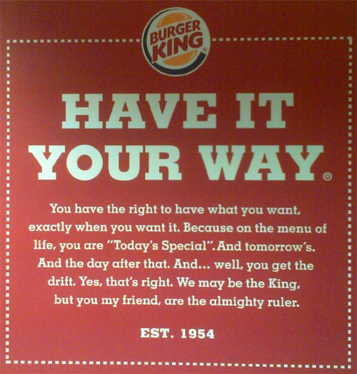

Slide 5
1 Corinthians 3:1-3 Brothers and sisters, I could not address you as people who live by the Spirit but as people who are still worldly—mere infants in Christ. I gave you milk, not solid food, for you were not yet ready for it.

Slide 6
Indeed, you are still not ready. You are still worldly. For since there is jealousy and quarreling among you, are you not worldly? Are you not acting like mere humans? For when one says, “I follow Paul,” and another, “I follow Apollos,” are you not mere human beings?

Slide 7
The Spirit of the Sovereign Lord is on me, because the Lord has anointed me to…
Isaiah 61:1

Slide 8
The Spirit of the Sovereign Lord is on me, because the Lord has anointed me to…
Isaiah 61:1

Slide 9
What’s Your Name?

Slide 10
Where You From?

Slide 11
What Do You Do?

Slide 12
Holy Spirit what’s HIS name?

Slide 13
Holy Spirit

Slide 14
Spirit of God

Slide 15
Spirit of Truth

Slide 16
Spirit of Christ

Slide 17
Holy Spirit where are you from?

Slide 18
Genesis -- Revelation
~ 380 O.T. (ruach) ~ 380 N.T. (pnuema) ~230-250 Holy Spirit

Slide 19
The earth was without form and void, and darkness was over the face of the deep. And the Spirit of God was hovering over the face of the waters.
- Genesis 1:2

Slide 20
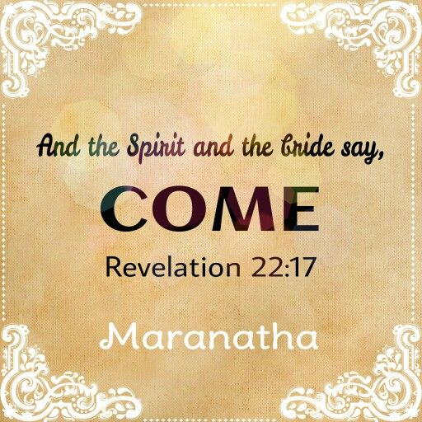

Slide 21
Holy Spirit what do You do?

Slide 22
Creates Advocates Searches Helps Intercedes Strengthens Convicts Grieves Leads Empowers
Knows Bears Witness Desires Comforts Counsels Sets Apart Fills Guarantees Comes On & In Gifts

Slide 23
The Spirit of the Sovereign Lord is on me, because the Lord has anointed me to…
Isaiah 61:1

Slide 24
God’s Spirit Came On:
Prophets Priests Kings Judges
Old Testament – Limited/Temporary

Slide 25
The world cannot accept Him, because it neither sees Him nor knows Him. But you know Him, for He lives with you and will be in you.
John 14:17

Slide 26
For the one whom God has sent speaks the words of God, for God gives the Spirit without limit.
John 3:34

Slide 27
For in Christ the whole fullness of Deity dwells bodily, and you have been filled in Him, who is the head of all rule and authority.
Colossians 2:9-10 (ESV)

Slide 28
…the mystery that has been kept hidden for ages and generations, but is now disclosed to the Lord’s people. To them God has chosen to make known among the Gentiles the glorious riches of this mystery, which is Christ in you, the hope of glory.
Colossians 1:26-27

Slide 29
The Spirit of the Sovereign Lord is on me, because the Lord has anointed me to…
Isaiah 61:1

Slide 30
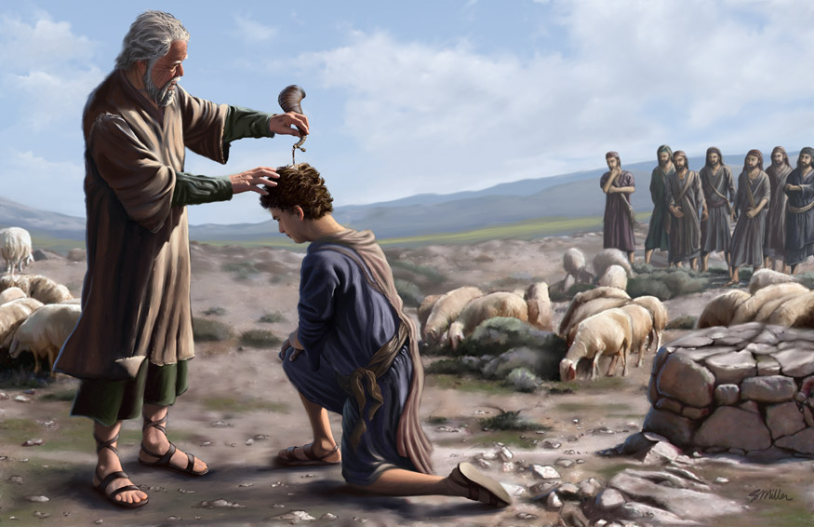

Slide 31
…how God anointed Jesus of Nazareth with the Holy Spirit and power, and how He went around doing good and healing all who were under the power of the devil, because God was with Him.
Acts 10:38

Slide 32
But you have an anointing from the Holy One [you have been set apart, specially gifted and prepared by the Holy Spirit]…
1 John 2:20 (AMP)

Slide 33
As for you, the anointing [the preparation] which you received from Him remains in you, and you have no need for anyone to teach you. But just as His anointing teaches you [giving you insight through the presence of the Holy Spirit] about all things, and is true and is not a lie, and just as His anointing has taught you, you must remain in Him.
1 John 2:27 (AMP)

Slide 34
To Anoint - Chrio
Anointing - Chrisma
Anointed One - Christo
Christians - Christois
We are “little christs”!
Prophets, Priests, Kings, & Judges ???

Slide 35
And hath made us kings and priests unto God and his Father; to him be glory and dominion for ever and ever. Amen.
Revelation 1:6 (KJV)

Slide 36
But you are a chosen people, a royal priesthood, a holy nation, God’s special possession, that you may declare the praises of him who called you out of darkness into his wonderful light.
1 Peter 2:9 (NIV)

Slide 37
What business is it of mine to judge those outside the church? Are you not to judge those inside? God will judge those outside. “Expel the wicked person from among you.”
1 Corinthians 5:12-13

Slide 38
To Anoint - Chrio
Anointing - Chrisma
Anointed One - Christo
Christians - Christois
Prophets, Priests, Kings, Judges
And Artists !

Slide 39
Then Moses said to the Israelites, “See, the Lord has chosen Bezalel son of Uri, the son of Hur, of the tribe of Judah, and he has filled him with the Spirit of God, with wisdom, with understanding, with knowledge and with all kinds of skills…
Exodus 35:30-35

Slide 40
…to make artistic designs for work in gold, silver and bronze, to cut and set stones, to work in wood and to engage in all kinds of artistic crafts.
Exodus 35:30-35

Slide 41
And he has given both him and Oholiab son of Ahisamak, of the tribe of Dan, the ability to teach others…
Exodus 35:30-35

Slide 42
He has filled them with skill to do all kinds of work as engravers, designers, embroiderers in blue, purple and scarlet yarn and fine linen, and weavers—all of them skilled workers and designers.
Exodus 35:30-35

Slide 43
How good and pleasant it is when God’s people live together in unity! It is like precious oil poured on the head running down on the beard, running down on Aaron’s beard, down on the collar of his robe.
Psalm 133:2

Slide 44
He anointed us, set his seal of ownership ON us, and put his Spirit IN our hearts as a deposit, guaranteeing what is to come.
2 Corinthians 1:21-22

Slide 45
But very truly I tell you, it is for your good that I am going away. Unless I go away, the Advocate will not come to you; but if I go, I will send Him to you.
John 16:7

Slide 46
Very truly I tell you, whoever believes in me will do the works I have been doing, and they will do even greater things than these, because I am going to the Father.
John 14:12

Slide 47
Very truly I tell you, whoever believes in me will do the works I have been doing, and they will do even greater things than these, because I am going to the Father.
John 14:12

Slide 48
Peter replied, “Repent and be baptized, every one of you, in the name of Jesus Christ for the forgiveness of your sins. And you will receive the gift of the Holy Spirit.
Acts 2:38

Slide 49
