Slide 1
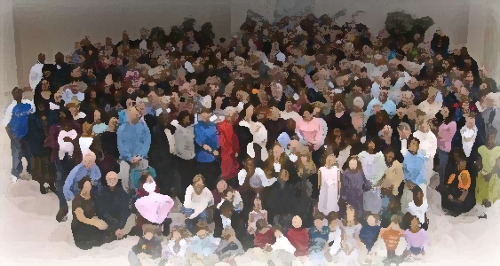
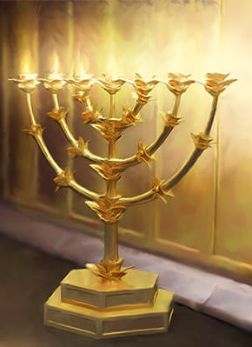
The Lampstand
at Central
The “Is-ness” of God
Revelation 1:8-11

Slide 2
He is coming with the clouds
Isaiah 19:1; Ezekiel 30:3; Daniel 7:13
“See the Lord rides on a swift cloud
and is coming to Egypt;
For the day is near – the day of the
Lord is near – a day of clouds,
a time of doom for the nations;
…there before me was one like a son of man,
coming with the clouds of heaven.

Slide 3
The Lord’s Interjection – V. 8
I AM speaks.
Alpha and the Omega
Α Ω
The “is-ness” of God
He has always been with us,
always will be with us
and is with us presently

Slide 4
The Almighty
Pantokrator - “All” (pan)
“prevailing one, mighty, strength” (krateo)
El Shaddai and El Sabaoth
EL - “might, strength, unrestricted power
and absolute dominion”
Shaddai – All sufficient
Sabaoth – Hosts, armies

Slide 5
Questions answered
Who, where, why, what &
from/to whom
Who? 9a
Your brother and companion
Close
relationship
Share something
in common
Suffering – “pressure”
Kingdom – We rule/live under the Ruler
Patient endurance – “remaining under or
even remaining behind.”

Slide 6
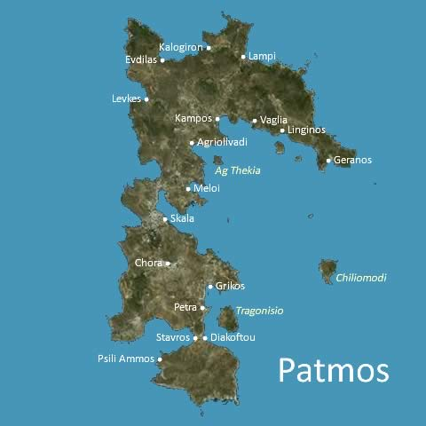
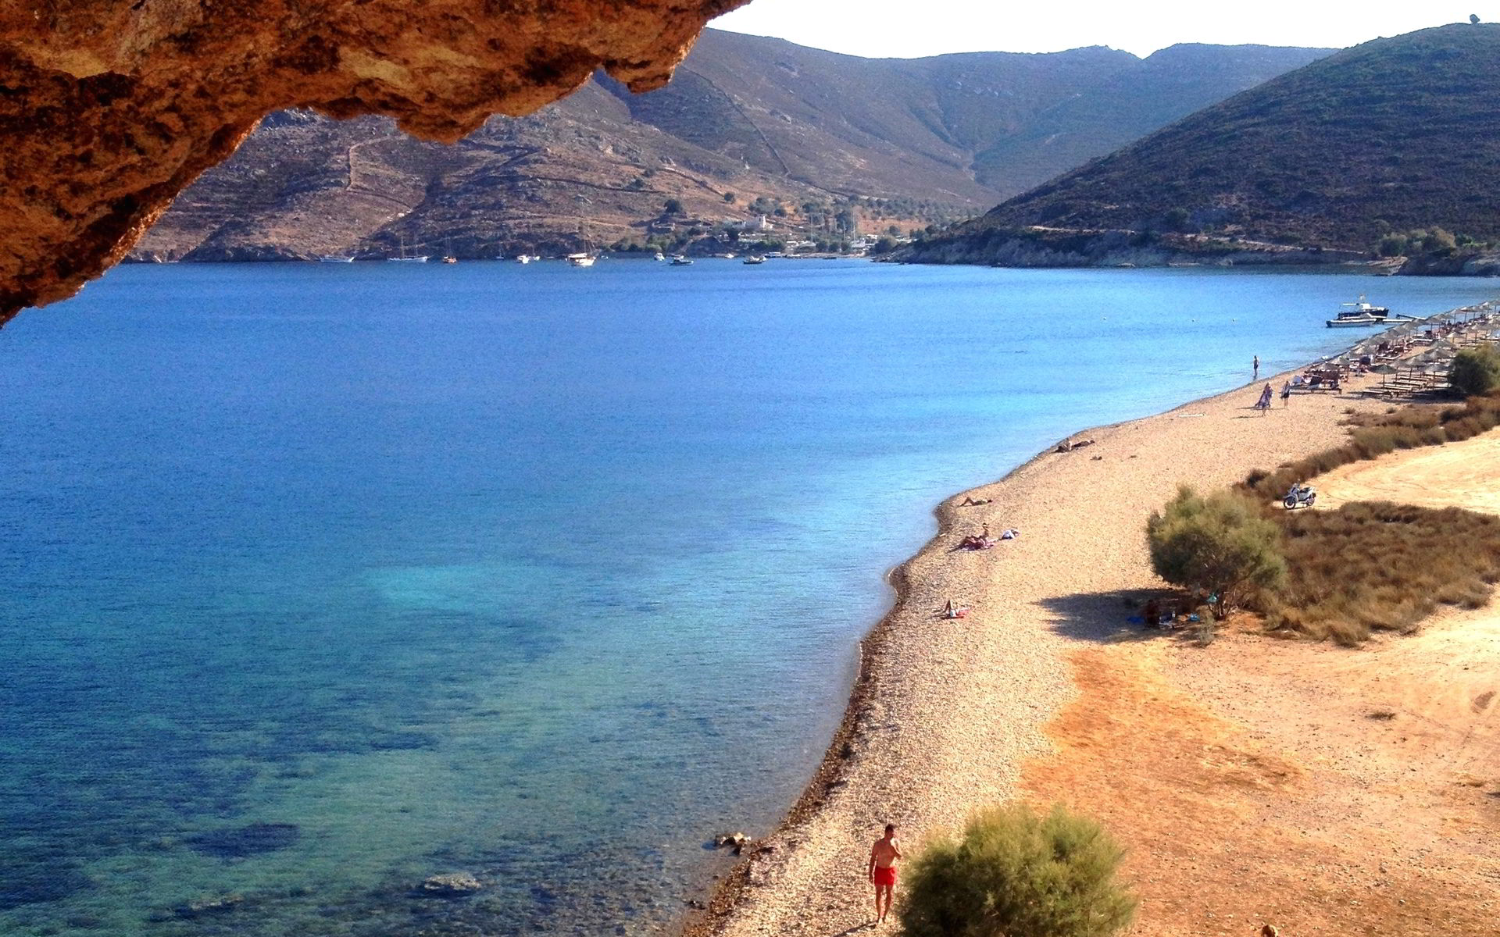
Questions answered
Where? 9b
under banishment

Slide 7
Questions answered
On the Lord’s Day – “Sunday”
In the Spirit - “in a state of spiritual ecstasy”
What? 10a
New Testament - “first day of the week”.
Came to mean a day especially set aside
for Christian “worship”.
From “day of worship” to an “hour of worship”

Slide 8
Questions answered
On the Lord’s Day – “Sunday”
In the Spirit - “in a state of spiritual ecstasy”
What? 10a
‘Special spiritual state’
Not normal – rare and unusual.
How do you get in the spirit?
What do I need to do? If I get there, am I more spiritual than you? Does God give me more insight in this state?
Do I have to be a super spiritual person?

Slide 9
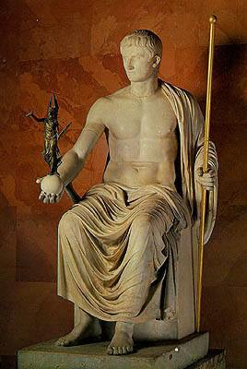
Questions answered
For the Christian every day
is the Lord’s Day
What? 10a
“In the Lord’s Day” instead of
“on the Lord’s Day”
Hebrews 3 “today”
“Today if you hear his voice…encourage one another daily as long as it is called Today.”
For the Christian it is always Today –
We live in the Lord’s day.
Life centered in Caesar

Slide 10
Questions answered
What? 10a
“In spirit” instead of “in the Spirit”
“in the Lord’s day I was in spirit”
The normal state of the Christian – we live in
the reality of spiritual life.
We live by the spirit, in and through the spirit.
We are indwelled by the Spirit.
“In spirit” is the constant state of our lives.

Slide 11
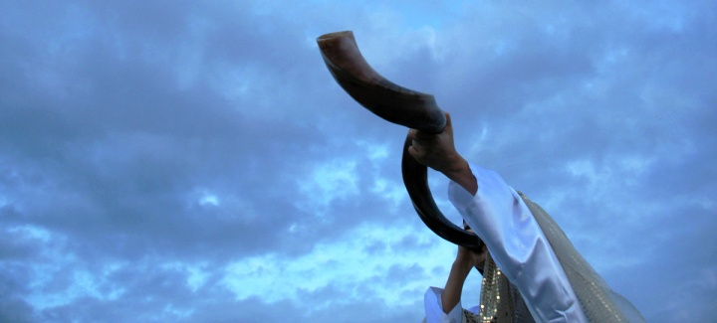
Questions answered
From/to Whom? 11
A loud voice
Like a trumpet
The seven churches:
Wholeness, completeness
We are to hear this voice – blessed are those who hear!

Slide 12
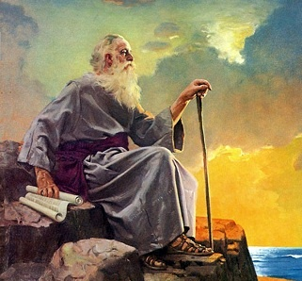
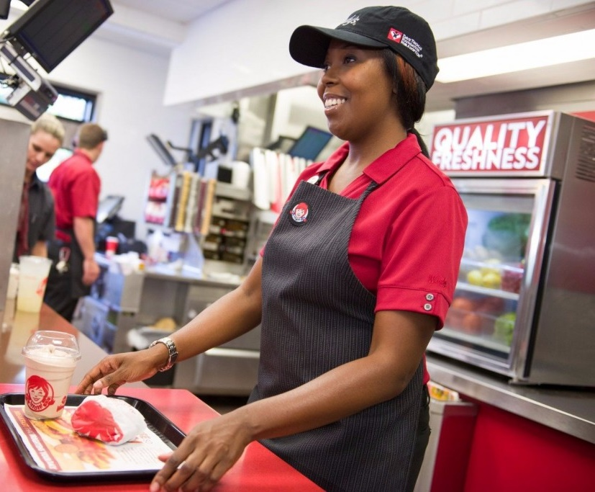
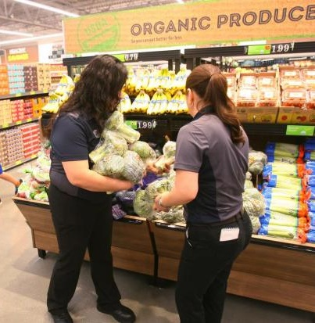
“on the job”
John was on the island of Patmos
Our reality is in spirit, in the Lord’s Day.

