Slide 1
Who You Are
2 John
How To Live

Slide 2
2nd John
Written to a person or a church?
A “cover letter” for 1st John?

Slide 3
The connection of Truth and Love
2 John 1:2-6
Bohemian Rhapsody
Is this the real life, is this just fantasy?
Jesus Christ
Life that is truly life
Nothing really matters, anyone can see, nothing really matter to me..
Jesus offers truth
Jesus offers love – connected to reality –
Because he is both

Slide 4
You are Special - Chosen
2 John 1:2
You see the heart of God by what he calls us.
I will change your name.
You shall no longer be called, wounded, outcast,
lonely or afraid.
I will change your name. Your new name shall be: Confidence, joyfulness, overcoming one, faithfulness, friend of God. One who seeks my face.
God Chooses You!
Now what is your choice?

Slide 5
God’s Greetings,
My Response
Grace – The good gift of life that we don’t deserve
Mercy – Not received the punishment we do deserve.
Peace – the result of God’s mercy and grace
2 John 1:3
Grace, Mercy and Peace

Slide 6
The Joy of Faithfulness
Great joy
“to the max”
2 John 1:4
Joy that gives to others
Joy that comes to you
Joy that God gives the believer.

Slide 7
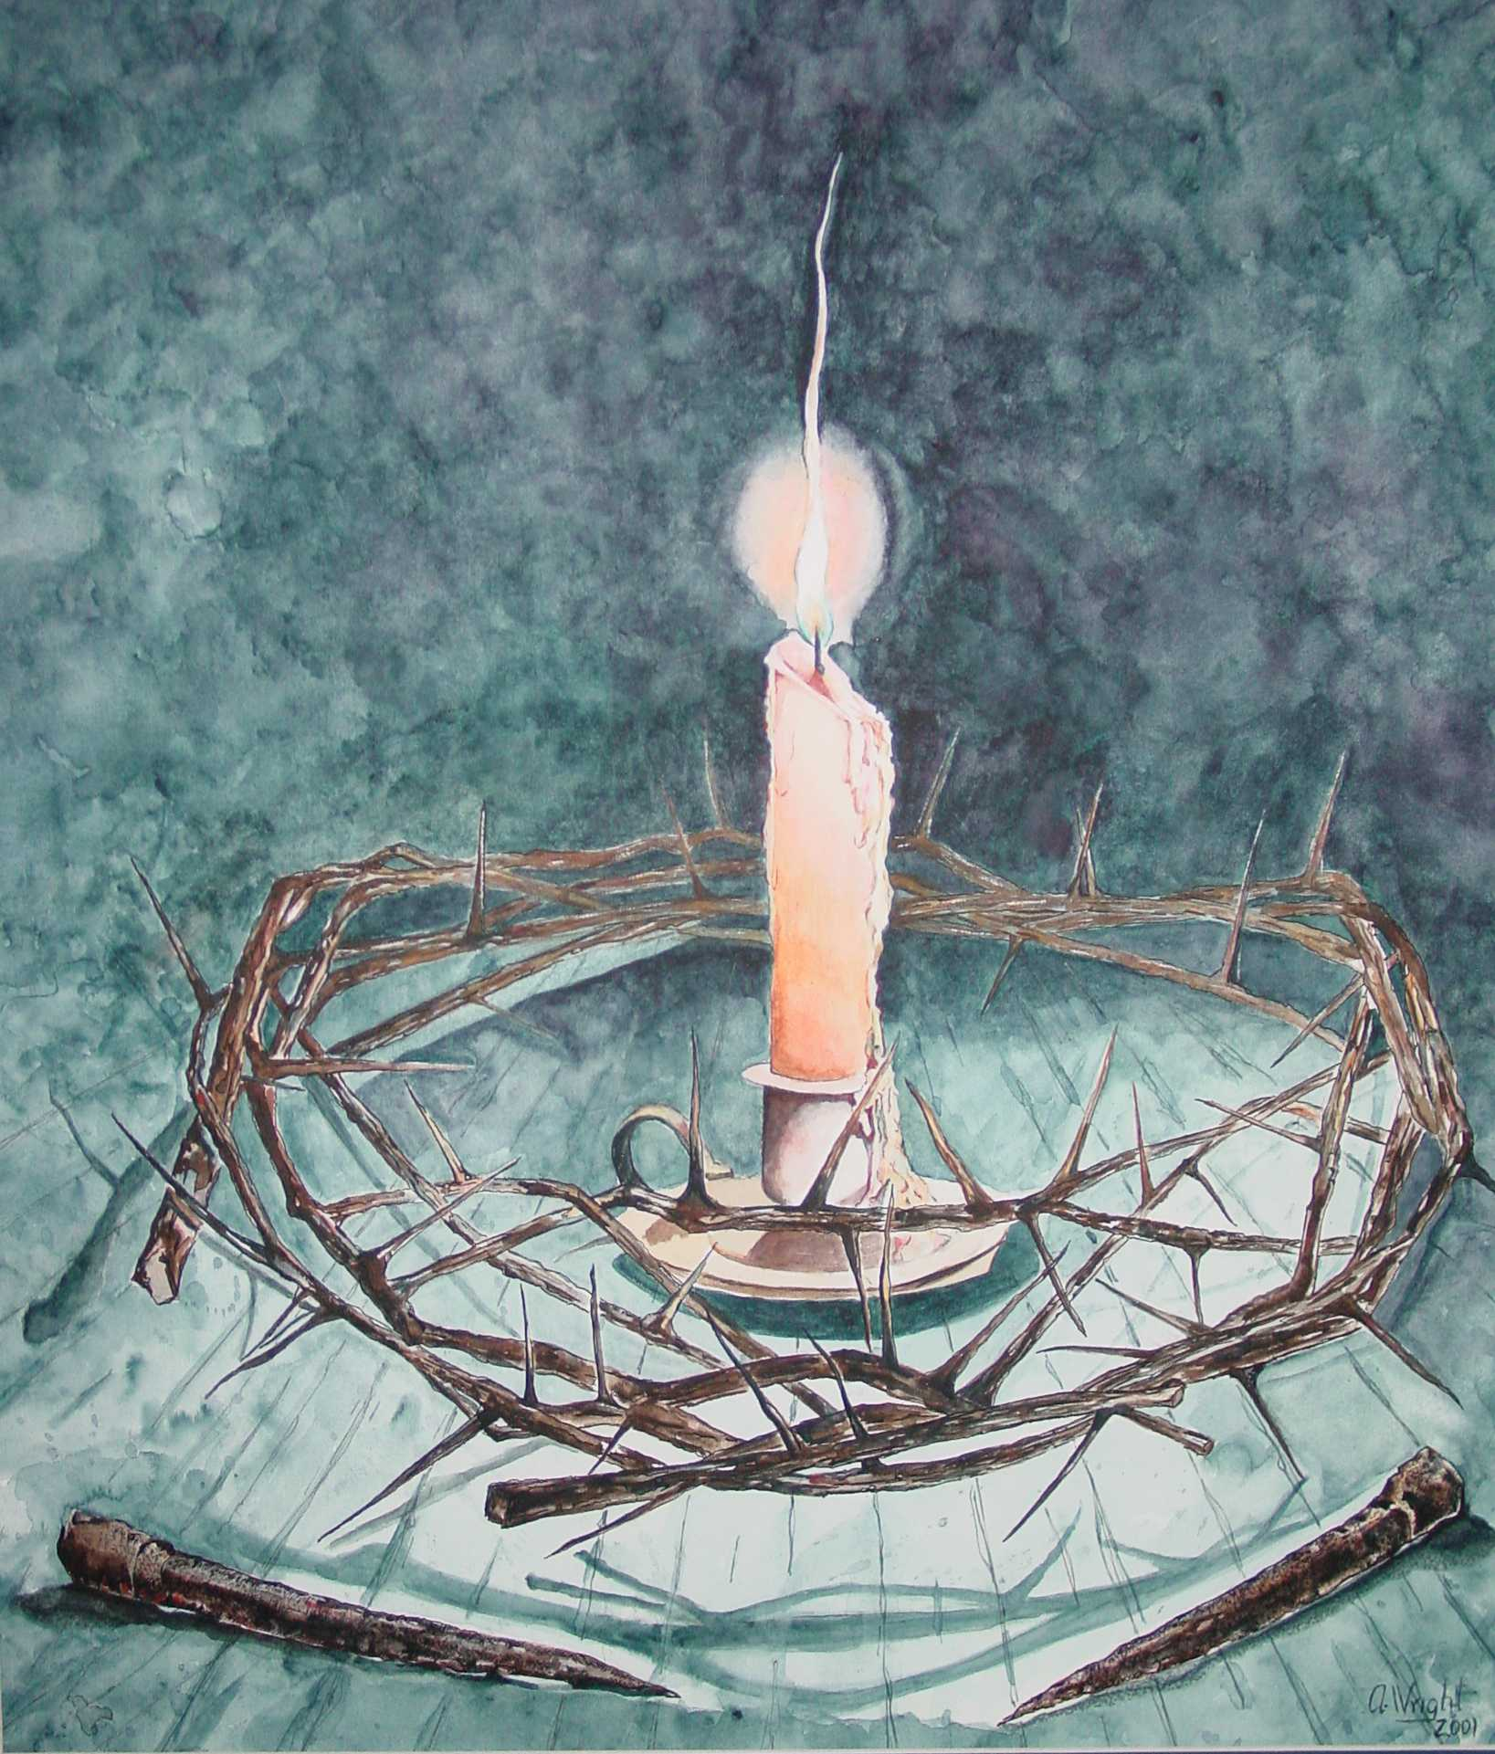
Love doesn’t always feel nice
“I ask that we love one another”.
2 John
1:5-11
Those who are intent on teaching against Christ should not be welcomed.
The purpose is not to reject but to help the person
turn back to God

Slide 8
How To Walk
4 ways to walk
In truth, love,
obedience and faith
Truth and love sum up the character of Jesus.
Obedience and faith is a response to his character.

Slide 9
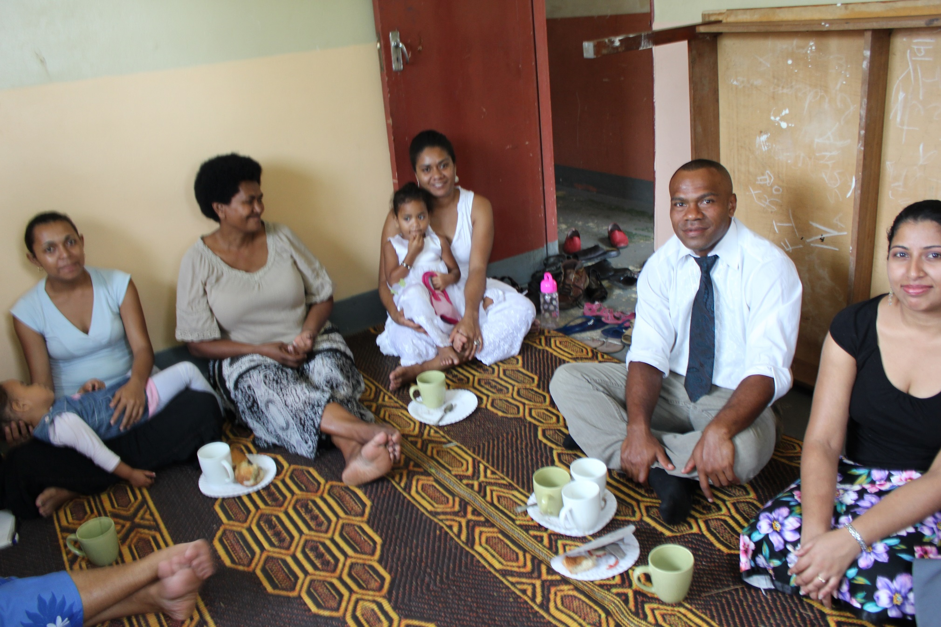
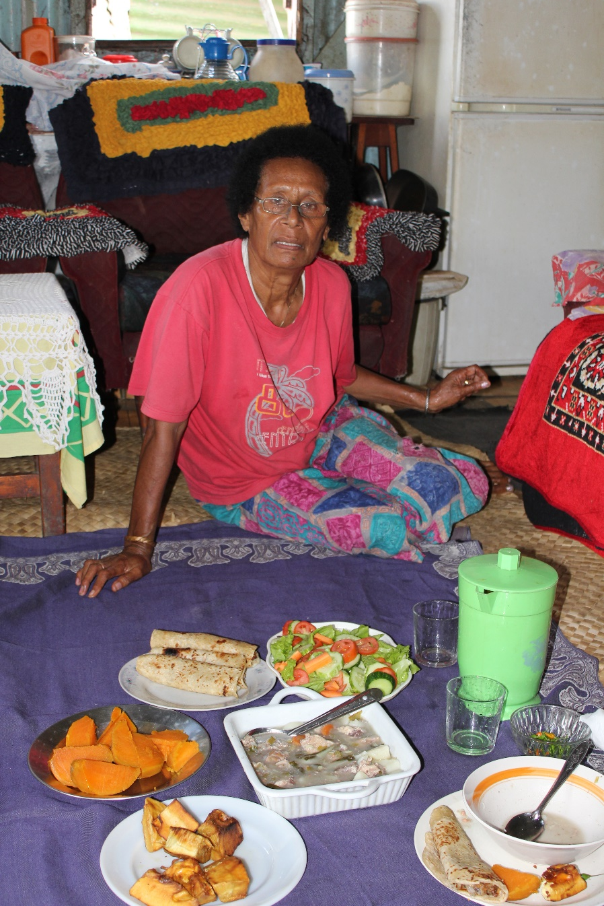
The Joy of hospitality v.12,13

Slide 10
2 John
Reminds us
“Who we are”
&
“How we are to live”

