Slide 1
God’s Greetings,
My Response
Grace, Mercy and Peace

Slide 2
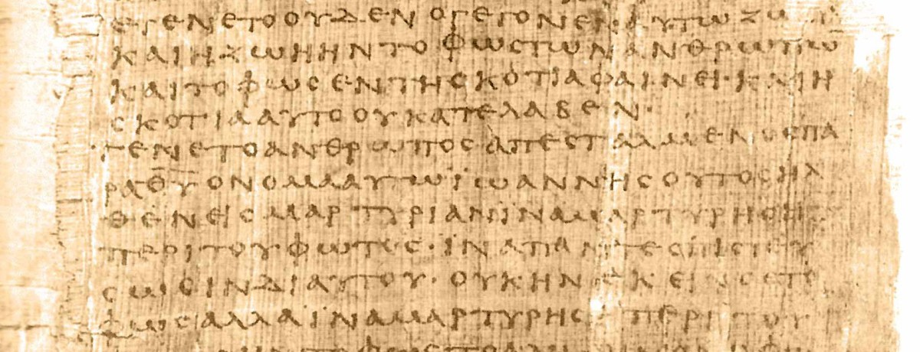
“Greetings”
Chairein - χαιρειν
“Grace, Mercy and Peace”
1 & 2 Timothy
2 John
Charis - χαρις
“Grace”

Slide 3
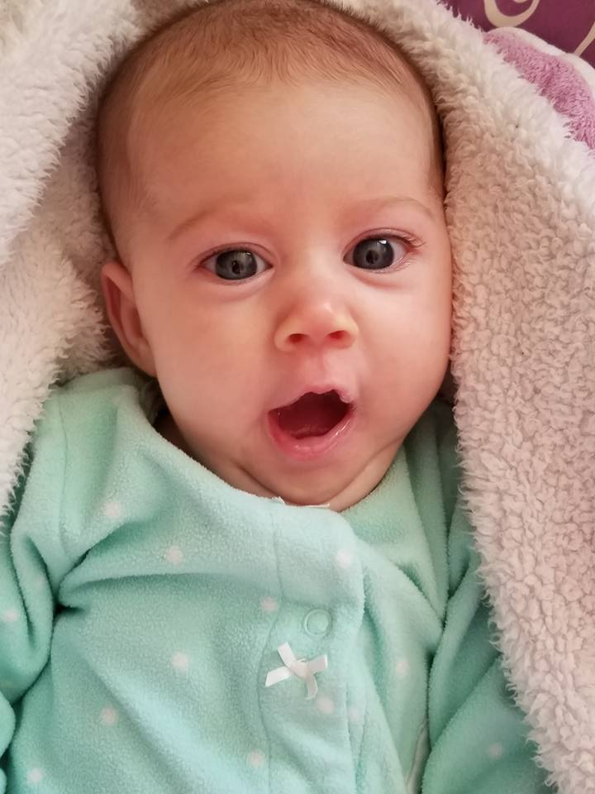
GRACE
Grace reveals the character of God
but also reveals the character of man
Marilyn Elizabeth Drucilla Grace
God’s gives to my need
For by grace you have been saved –
it is the gift of God.
Ephesians 2:8

Slide 4
GRACE
God’s generosity
because I’m helpless
For by the trespass of the
one man, death reigned… consequently [there was]
condemnation of all…but
Marilyn Elizabeth Drucilla Grace
the gift is not like
the trespass. How much more did God’s grace and the gift that came by the grace of …Jesus overflow to the many. Romans 5:17,18,15

Slide 5
GRACE
God’s riches because of my poverty
For you know the grace of our Lord Jesus Christ, that though he was rich, yet for your sakes he became poor, so that you through his poverty might become rich.
2 Cor. 8:9
Marilyn Elizabeth Drucilla Grace

Slide 6
“We read, we hear, we believe a good theology of grace. But that’s not the way we live.
The good news of the gospel of Grace has not penetrated
the level of our emotions.”
David Seamands

Slide 7
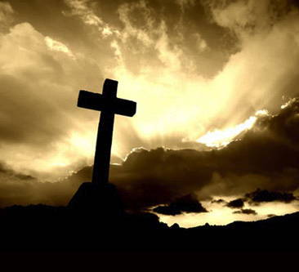
MERCY
“Is God fair?”
Matthew 20:1-16
God is more than fair which is
wonderfully “unfair”
The steadfast love of the Lord never ceases,
his mercies never come to an end.
They are new every morning.
Lamentations 3:23

Slide 8
MERCY
3 principles of
God’s mercy
You must ask for mercy
Lk 18:10
Once you’ve received mercy you must give mercy
Matthew 18:21ff
We must never take advantage of mercy
John 8:1-11

Slide 9
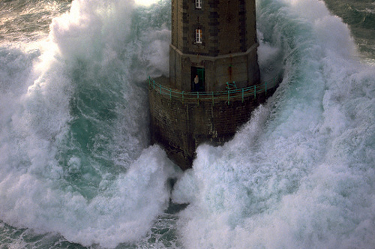
PEACE
Comes after we have received grace and mercy
Our greatest anxiety is caused by broken relationships and when our relationship
with God is broken through sin we
have our greatest anxiety.

Slide 10
PEACE
Peace be yours in abundance
2 Pet 2:2
Hebrew greeting – Shalom
Wholeness, a great sense of well-being,
fulfillment and contentment – a security.
Everything is complete and right.

Slide 11
PEACE
You will keep in perfect peace him whose mind is steadfast, because he trusts in you
Isaiah 26:3
“I’ve learned to be content in every circumstance…”
Phil 4:11
Therefore we have been justified by faith, we have peace with God through our Lord Jesus Christ.
Romans 5:1

Slide 12
Sin breaks peace to pieces…
Grace, mercy and peace…
will be with us.

Slide 13
Peace, perfect peace, in this dark world of sin? The blood of Jesus whispers peace within.
Peace, perfect peace, by thronging duties pressed? To do the will of Jesus, this is rest.
Peace, perfect peace, with sorrows surging round? On Jesus’ bosom naught but calm is found.
Peace, perfect peace, with loved ones far away? In Jesus’ keeping we are safe, and they.

Slide 14
Peace, perfect peace, our future all unknown? Jesus we know, and He is on the throne.
Peace, perfect peace, death shadowing us and ours? Jesus has vanquished death and all its powers.
It is enough: earth’s struggles soon shall cease, And Jesus call us to Heaven’s perfect peace.

