Slide 1
Refocus with Jesus’ Focus
Part Two
Mark 9
Right side up living in an upside down world

Slide 2
“…two things matter more than anything else, truth with a lower case t and Truth with an upper case T. You have to tell the truth, demand truth from others, recognize lies and refute them;…And the bigger kind of Truth, that life has meaning, is the surest source of happiness, because it allows you to recognize your true value and potential, encourage a humility that brings peace. Most importantly the big-T Truth makes it possible for you to love other….”

Slide 3
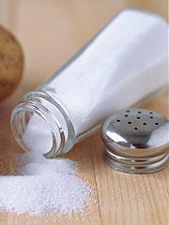
Learning to think properly is learning
to think like Jesus –
because he’s the “Truth”
You are the salt and the light of the world
“This is my Son whom I love.
Listen to him!”
#1
Dependency on God.
#2

Slide 4
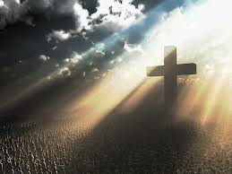
The
of his mission
“The Son of Man is going to be betrayed…they will
kill him, and after three days he will rise.”
9:31
Mark 9:30-32
Application:
Don’t let anyone or anything distract you from the focus of your mission in Christ.

Slide 5
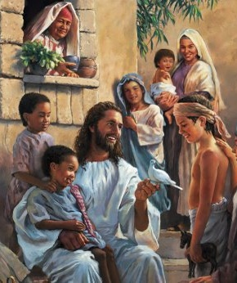
Application:
Focus on putting others first in your home, work and every other aspect of life
The
of greatness
Mark 9:33-36
“...they had argued about who was
the greatest”
9:34
The principle of greatness:
Be the last/servant/slave

Slide 6
LISTEN TO HIM!

Slide 7
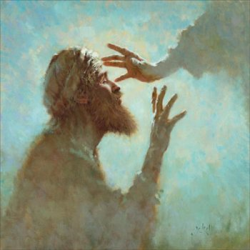
Son of David – have mercy of me!
Lord have mercy – I just want to see.

